Slide 1

Sustainable Public Procurement, a strategic tool to achieve sustainability and transform markets.
Presentation of the results of the 2017 Global review of SPP with key success stories.
Farid Yaker / November 23 2017 /Kyiv, Ukraine

Slide 2



UN Environment promotes the worldwide implementation of Sustainable Public Procurement (SPP), a powerful instrument that has the ability to accelerate the shift to more sustainable consumption and production practices. Through its various projects, UN Environment supports the development and implementation of SPP policies in 13 countries and fosters regional cooperation and exchange of know how in Latin America and Asia Pacific. UN Environment is also the lead of the 10YFP SPP programme, an international collaborative platform that aims at making the case for SPP and supporting all organizations on SPP implementation.
Farid.yaker@un.org

Slide 3

What is Sustainable Public Procurement (SPP) ?
“a process whereby public organizations meet their needs for goods, services, works and utilities in a way that achieves value for money on a whole life-cycle basis in terms of generating benefits not only to the organization, but also to society and the economy, whilst significantly reducing negative impacts on the environment.”
It is not necessary to have a slide with a quote in all presentations. This slide can be used in other similar context as well.
Definition adopted under the 10 YFP SPP Programme
3
Slide numbers to be added
as shown alongside

Slide 4
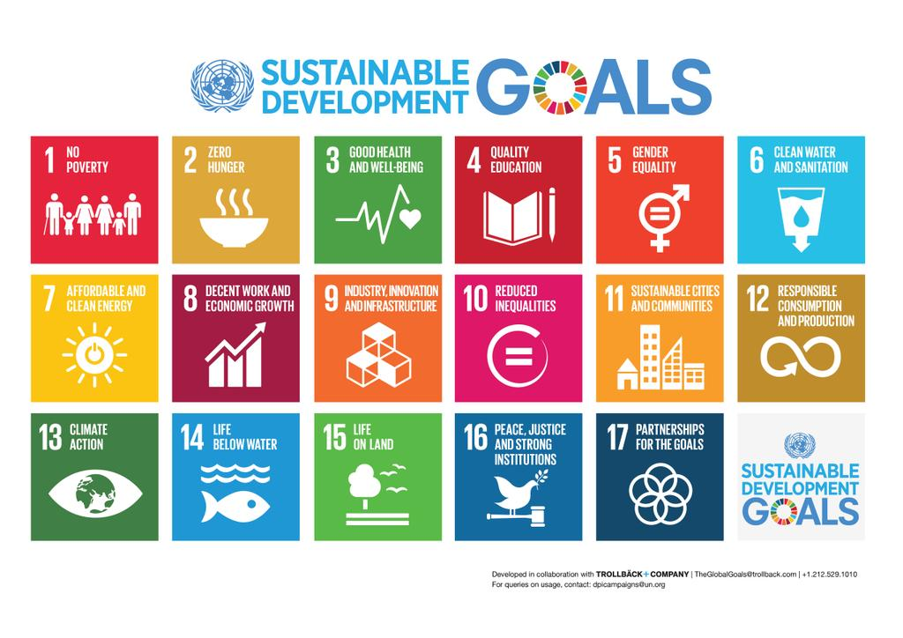
SPP in the Sustainable Development Goals
Notes:
ODS 12 propuesto: Promover patrones de producción y consumo sostenible.
ODS 12.7: Asegurar prácticas de compras públicas que sean sostenibles y alineadas con las políticas y prioridades nacionales

Slide 5

SPP in the Sustainable Development Goals
Procurement processes that consider social, economic and environmental factors are able to drive sustainability along value chains.
SDG 12: Ensure sustainable consumption and production patterns
Target 12.7: Promote public procurement practices that are sustainable in accordance with national policies and priorities.
Indicator 12.7.1 Number of countries implementing sustainable public procurement policies and action plans
Notes:
Public procurement wields enormous purchasing power, accounting for an average of 12 percent of gross domestic product (GDP) in OECD countries, and up to 30 percent of GDP in many developing countries.
Leveraging this purchasing power by buying more sustainable goods and services can help drive markets in the direction of sustainability, reduce the negative impacts of an organization, and also produce positive benefits for the environment and society.
In September 2015, world leaders adopted the 2030 Development Agenda. At its core are 17 so-called Sustainable Development Goals (SDGs) that seek to build on the Millennium Development Goals, and take into account the three dimensions of sustainable development: economic, social and environmental. The SDGs have reiterated the strong link between environmental protection, sustainable development, and public procurement
The advancement of sustainable public procurement (SPP) practices is thus recognized as being a key strategic component of the global efforts towards achieving more sustainable consumption and production patterns.

Slide 6


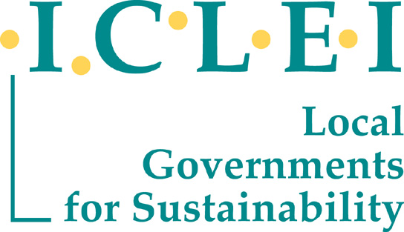
The 10 YFP SPP programme led by UN Environment

Slide 7
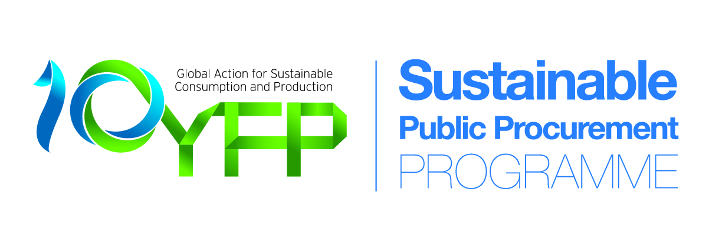
What is the 10YFP?
The 10-Year Framework of Programmes on Sustainable Consumption and Production Patterns (10YFP) is a concrete and operational outcome of Rio+20 Conference.
It is a global framework that enhances international cooperation to accelerate the shift towards sustainable consumption and production (SCP) in both developed and developing countries.
It provides capacity building and technical and financial assistance to developing countries, and encourages innovation and cooperation among all countries and stakeholders.
© NABU/Holger Schulz
7

Slide 8

The six programmes of the 10YFP
Consumer information
Sustainable lifestyles and education
Sustainable public procurement
Sustainable buildings and construction
Sustainable tourism, including ecotourism
Sustainable food systems
8

Slide 9

The 10YFP SPP Programme
working together to accelerate the shift to SPP
A global multi-stakeholder platform that brings together a variety of SPP stakeholders to foster communication, leverage resources and achieve common objectives:
  Improve knowledge on SPP and its effectiveness as a tool to promote greener economies and sustainable development;
  Support the implementation of SPP on the ground: better access to capacity building tools and support through SPP experts.

Slide 10


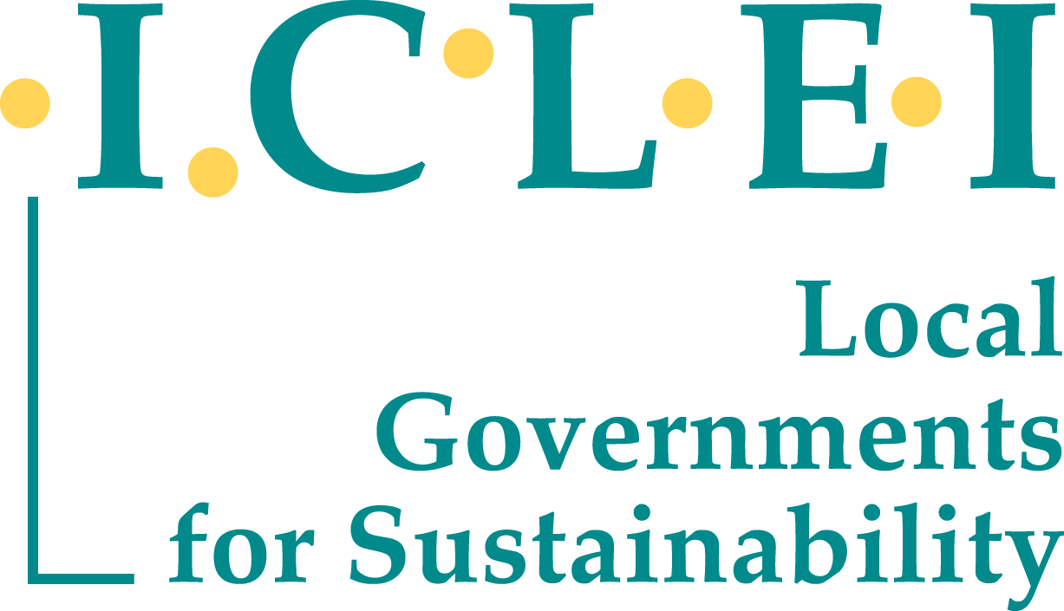
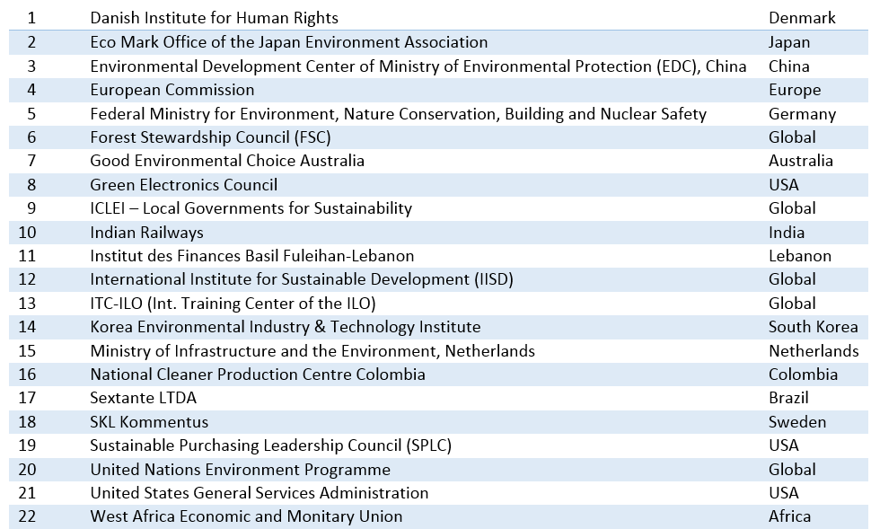
Governance structure: new MAC 2017-2019
10

Slide 11
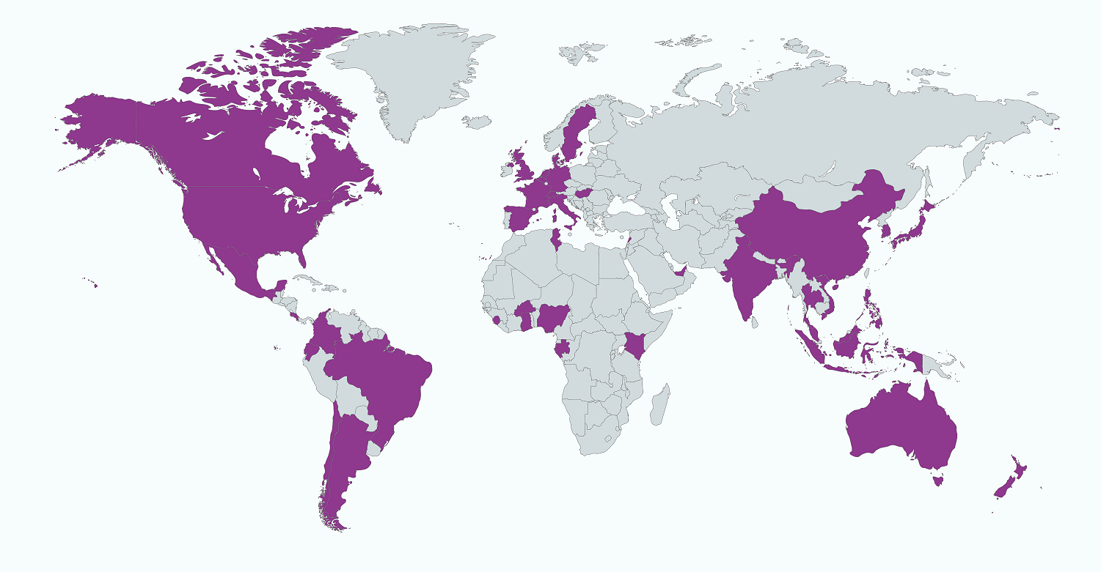
The 10 YFP SPP Programme global presence
108 Partner Organizations and 14 individual Experts
in more than 40 countries around the globe
(as of November 2017)
11

Slide 12
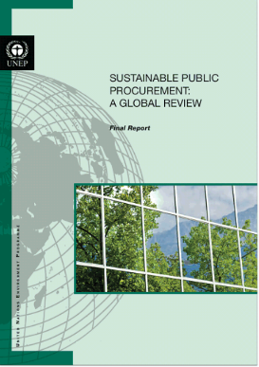
2013 Global Review of SPP
an investigation into the national government SPP/GPP policies and practices around the world
based on an analysis of literature and online resources, and interviews with 20 leading experts on SPP/GPP
Six case studies that delve deeper into particular countries' recent experiences with SPP/GPP
The result: a global view that considers the challenges and opportunities for SPP/GPP in different governmental, regulatory and socio-economic contexts, and highlights the evolution of SPP/GPP in recent years.
Available here

Slide 13
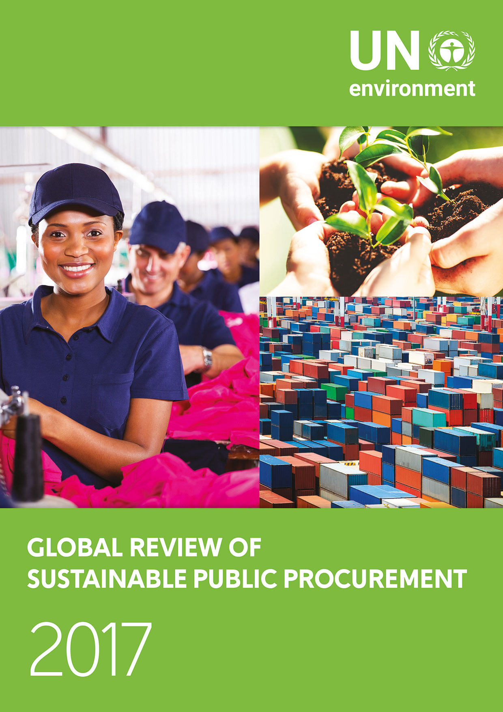
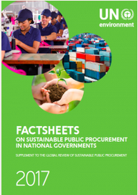
2017 Global Review of SPP - A global report periodically reviewing the implementation of SPP
Now available on the global SCP Clearinghouse platform in all six official UN languages. Click here to read.

Slide 14
Main findings of the 2017 Global Review of Sustainable Public Procurement

Slide 15
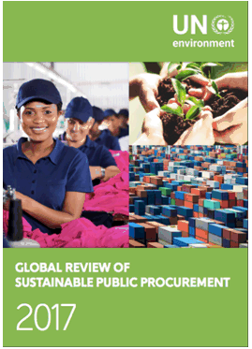
2017 Global Review of SPP: objectives
The investigation of the current ‘state-of-play’ in national government sustainable purchasing activities around the world, highlighting recent activity, trends, challenges and opportunities
What the study is not: a definitive, verified and comparable list of countries implementing sustainable public purchasing
15
Notes:
Study commissioned and reviewed by the 10YFP SPP Programme Coordination desk, composed with UN Environment – ICLEI – KEITI
Authored by:
Aure Adell & Bettina Schaefer, Ecoinstitut SCCL
Anastasia O’Rourke, Angela Vitulli & Noma Moyo, Industrial Economics, Inc
Tim Reeve, Reeve Consulting

Slide 16
2017 Global Review of SPP: research methods
Literature and desktop review
Expert interviews
(6 experts)
Questionnaire
(41 national governments)
Best practices
(4 case studies)
Global survey
(201 respondents)
16
Notes:
The 2016 Review is informed by primary and secondary research including:
A literature review and analysis of over 70 sources published between 2012 and 2015 on the topic of sustainable public procurement (and related terms).
Six in depth, semi-structured interviews with experts in sustainable public procurement from different world regions.
A questionnaire to gather data on sustainable public procurement by national governments. The questionnaire was sent to 56 countries. 41 countries ultimately participated.
Four best practice examples were compiled to suggest possible solutions to the needs and barriers identified.
A survey conducted online between May and June 2016, targeting a broad range of stakeholders from international to local public authorities, companies and enterprises, consultants involved in SPP, NGOs, standards and certification organisations, and research institutions. 201 participants completed the survey, from a variety of world regions and types of organisations.

Slide 17
2017 Global Review of SPP: world regions’ representation
National Governments questionnaire (sample=41)
Stakeholder survey
(sample=201)
17
Global Review of SPP, 2016
Notes:
The 2016 Review is informed by primary and secondary research including:
A literature review and analysis of over 70 sources published between 2012 and 2015 on the topic of sustainable public procurement (and related terms).
Six in depth, semi-structured interviews with experts in sustainable public procurement from different world regions.
A questionnaire to gather data on sustainable public procurement by national governments. The questionnaire was sent to 56 countries. 41 countries ultimately participated.
Four best practice examples were compiled to suggest possible solutions to the needs and barriers identified.
A survey conducted online between May and June 2016, targeting a broad range of stakeholders from international to local public authorities, companies and enterprises, consultants involved in SPP, NGOs, standards and certification organisations, and research institutions. 201 participants completed the survey, from a variety of world regions and types of organisations.

Slide 18
What is the SPP policy framework?
61%
34%
32%
of the national governments surveyed include SPP in ENVIRONMENTAL POLICIES
in SOCIO-ECONOMIC POLICIES
in SUSTAINABLE DEVELOPMENT STRATEGIES
Global Review of SPP, 2016
18
Notes:
The inclusion of SPP has increased in all policy arenas compared to the 2013 Review results.
As one interviewee said, “one of the new trends in relation to SPP is looking at SPP far more strategically and embedding it more into governments’ policies and most importantly action plans.”

Slide 19
What type of sustainability issues are addressed by SPP policies? (1/2)
Most national governments have SPP commitments that cover both environmental and socio-economic issues.
74% 26%
Focus on BOTH environmental and socio-economic issues.
Focus ONLY on environmental issues
The focus is still prominently on environmental issues, but socio-economic ones are increasingly taken into account.
19
Global Review of SPP, 2017
.
Notes:
Most national governments have SPP commitments that cover both environmental and socio-economic issues. Some governments, particularly in Asia, focus exclusively on environmental issues, and are not yet focusing on the socio-economic dimension. This is also the case in certain European countries. However, others, such as Belgium, prioritize an impressive range of socio-economic and ethical issues in addition to focusing on the environment.

Slide 20
What type of sustainability issues are addressed by SPP policies? (2/2)
Environmental issues
Socio-economic issues
20
Global Review of SPP, 2017
.
Notes:
On the social side, diversity and equality have shown a significant growth in prominence compared to 2012, when “diversity” appeared in the least amount of policies of all social issues considered. This suggests an evolution from a focus on the social issues most closely tied to economic performance (e.g. employment and business development) toward the inclusion of issues related to human wellbeing and social justice.

Slide 21
What categories of products, services and works are prioritised?
Office IT | 89%
Office paper and stationary | 85%
Vehicles | 70%
Cleaning | 67%
Furniture | 63%
Buidling design and construction | 59%
Building equipment | 59%
Building materials | 52%
Energy | 52%
Textiles | 52%
Food and catering | 44%
Chemical products | 37%
Household appliances | 37%
Infrastructure design and construction | 33%
Waste collection and street cleaning | 22%
Travel services | 15%
Works execution | 15%
21
Global Review of SPP, 2016
.
Notes:
In the coming years, we might see a shift in this approach. Identifying priority categories is typically done in the initial stages of development of SPP policies. Today, the focus of policy-makers seems to be moving towards inserting SPP provisions across all categories of products and concentrate on achieving wider environmental goals e.g. fighting climate change, achieving a circular economy etc.

Slide 22
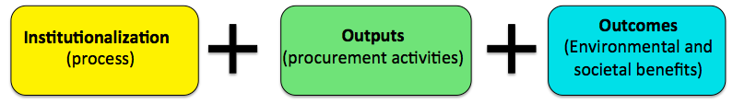
What aspects are monitored? (1/2)
22
Global Review of SPP, 2017
.
Notes:
About one third of governments monitor outcomes (benefits/impacts on the environment and society generated by the SPP practices)
Institutionalization refers to the process and actions undertaken by an organization to integrate and embed SPP in that organization’s culture and daily operations.
Outputs are the direct results of the procurement activities and can be divided into four groups: i) procurement processes (tenders, contracts, procurement orders) including sustainability criteria; ii) sustainable products, services or works purchased; iii) contract with or purchase from preferred companies; and iv) direct generation of employment opportunities, the latter being an output as well as an outcome.
Outcomes are the benefits to, or impact on, the environment and society generated by the SPP practices.

Slide 23
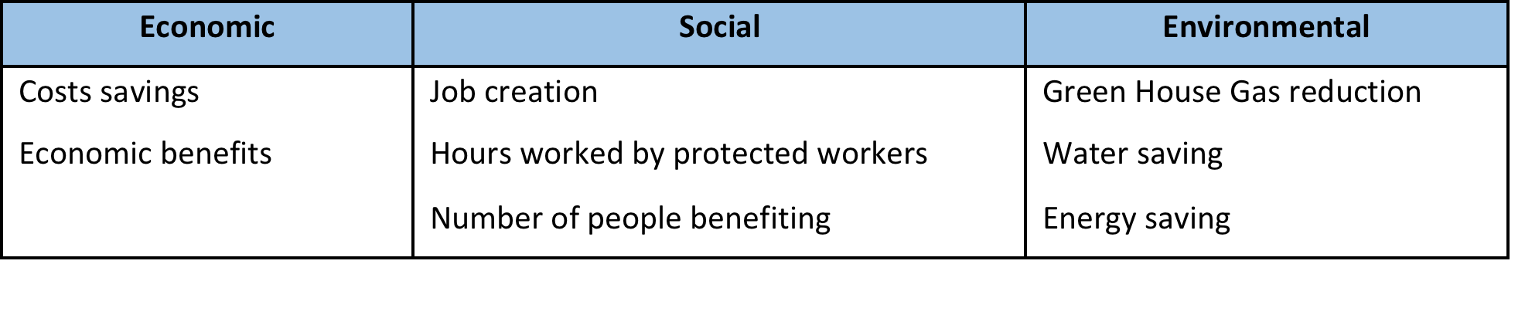
What aspects are monitored? (2/2)
Process-related indicators are most common, as data is more easily available.
Output-related indicators are increasingly being monitored. This might increase, as e-procurement systems become the norm.
Estimating or calculating the sustainability benefits of SPP is still a significant challenge and is rarely done.
Types of indicators used to estimate SPP outcomes:
23
Global Review of SPP, 2017
.
Notes:
When estimating SPP outcomes, social indicators that are the most frequently mentioned are job creation, hours worked by protected workers and number of people benefiting.
A variety of indicators are tracked by national governments to monitor SPP institutionalization. These include: the percentage of staff that include SPP in their performance evaluations, the percentage of procurers trained in SPP, the number of local authorities with SPP policies or that are addressing SPP, and the number of product groups for which SPP criteria have been developed.
National governments monitor SPP outputs – which may include the measurement of procurement with sustainability criteria, sustainable products purchased, or purchases from preferred companies – both in number of transactions and in economic volume (eight and thirteen national governments respectively). These figures are expressed either in absolute terms, as a percentage of the total volume of procurement, or as a percentage over prioritized product groups.
When estimating SPP outcomes, the indicators mentioned most frequently are greenhouse gas emissions reduction (four national governments), job creation (two national governments), and cost savings (two national governments). They are summarised in the table.

Slide 24
Strongest drivers of SPP in survey participants’ organizations
57%
38%
38%
29%
29%
28%
28%
24%
Policy commitments/goals/action plans
Strong political and organizational leadership on SP
Mandatory SP rules/legislation
Training of procurement staff in SP
Expertise in SP: legal, environmental, social, economic
Availability of SP criteria and specifications
Personal commitment to sustainability by staff
Monitoring, evaluation and enforcement of SP policies
24
Global Review of SPP, 2016
.
Notes:
The drivers most often selected by survey participants all suggest that a "top down" approach to implementation is the most common
These results are similar to those obtained in 2013, although the comparative importance of policy as a driver has grown. In fact, “policy” fell behind “national legislation” and “political and organizational leadership” in 2013. It is unsurprising to see the importance attached to the role of policy and mandatory rules in encouraging SP, given the proportion of respondents from the public sector; however, “policy commitments/goals and action plans” were identified as being top drivers for implementation even by private sector respondents.
GEOGRAPHIC TREND: Survey participants from Europe and South America were the most likely to choose "policy commitments and goals", while participants from North America were more likely to select "mandatory rules and regulations."

Slide 25
Main barriers to SPP in survey participants’ organizations
Perception that sustainable products and/or services are more expensive
Lack of expertise on SP implementation
Lack of policy commitments/goals/action plans
Lack of strong political and organizational leadership on SP
Lack of mandatory SP rules/legislation
Lack of sustainable products and/or services to purchase
Insufficient monitoring, evaluation and/or enforcement of SP policies
Competing procurement priorities
33%
33%
30%
28%
28%
26%
25%
22%
25
Global Review of SPP, 2016
.
Notes:
the two most commonly cited barriers to SPP implementation were the "perception that sustainable products and/or services are more expensive" and the "lack of expertise in sustainable public procurement implementation". The most important barriers persist from 2013, when the perception of added costs, lack of information and knowledge of SPP, and lack of technical capacities in environmental and social issues topped the list. Some barriers are more specific to regions and/or types of organizations, while certain other barriers are widely experienced by organizations working on SP. The wording in the 2013 Global Review for this barrier was “lack of technical capacities on environmental/social issues” (“capacity” is a very similar concept to “expertise” used in 2016). UNEP, 2013, Sustainable Public Procurement: A Global Review 2013 p.40: http://www.scpclearinghouse.org/resource/sustainable-public-procurement-global-review-2013 .
National government participants tended to choose "lack of expertise in sustainable public procurement" most often, and were much less likely than other groups to choose the "perception that sustainable products and or services are more expensive”, which is notable given their intimate knowledge of actual contract and bid pricing.
GEOGRAPHICAL TREND: The barrier cited most often by participants based in North America was "competing procurement priorities", while for participants based in Europe the most common barrier was "insufficient monitoring, evaluation and/or enforcement of SPP policies". For participants based in Asia and South America, the barrier mentioned most frequently was the "lack of sustainable products and/or services to procure". This suggests that in these regions, the market for sustainable products and services has yet to mature, and availability continues to be an important barrier to be addressed.

Slide 26
Challenges vs. possible solutions
Perception that sustainable
products are too expensive
Life-cycle costing
Lack of expertise
Training and lesson-sharing
Stimulating the maturity of the market and ecolabelling programmes
Low market availability of sustainable products
Professionalization of procurement and procurement modernization programmes
Competing procurement priorities
26
Global Review of SPP, 2017
.
Notes:
While some of these barriers are significant or persistent, it is encouraging to note that they can be overcome. Greater adoption of methodologies based on life-cycle costing will play a big role in helping to address concerns about costs. This is critical, as almost all national governments are seeking methods to be cost effective, and greater consideration of the full life-cycle costs of products and services is a key element of fiscal responsibility. The EU Procurement Directive should help to deepen the practice of life-cycle costing.
Other barriers such as a lack of expertise in SPP can be overcome with more focus on training and knowledge sharing, and concerns about the local availability of sustainable products and services should diminish as the ‘green’ marketplace matures and ecolabelling programmes continue to expand. However, it will be more difficult to address the barrier related to ‘competing priorities’; stakeholder interviews indicate that it is commonplace for procurement groups to be under-resourced and often overwhelmed by the volume of work delegated to them. Until procurement teams are adequately resourced for their core operations, it will be difficult for them to adopt best management practices. This means that the business case for SP must be linked to, and integrated within, procurement modernization programmes.

Slide 27
Perceived change in importance of SPP since 2012
SPP stakeholders perceive that sustainable procurement has become more important in both their country and organization.
All public-authority participants stated that SP has become “more important” for their organisations since 2012.
Participants based in Central and South America saw a sharp rise in the perceived importance of SP since 2012.
Stakeholders also expect SP will become more widespread in the next five years, despite changing political climates.
27
Global Review of SPP, 2017
.
Notes:
In the 2013 Review, we asked stakeholders whether they expected their national governments to do more SPP in the coming five years. Over 84 percent of the 2013 survey participants stated that it would grow either more or substantially more. In 2016, to understand whether these expectations had been met, we asked stakeholders whether they thought that SPP actually had grown in prominence since 2012, both in their own organisations and in their country.
Results suggest that expectations largely have been met:
-Respondents perceive that SP has become “more important” in both their country and their own organisation. Remarkably, all public-authority participants stated that SP has become “more important” for their organisations since 2012.
Participants based in Central America/the Caribbean and South America saw a sharp rise in the perceived importance of SP since 2012.
Participants generally had higher expectations for an increase in SPP activity from their organization than from their national government. This pattern is constant across world regions, except for participants in Europe, whose expectations were higher for national governments compared to their own organizations. One respondent from Asia commented that their expectation was contingent upon "whether or not the awareness and capacity-building work is done". Another respondent from the U.S. said that their expectations will likely change "depending on the results of the U.S. presidential election in 2016". The results suggest that, despite changing political climates, organizations are likely to continue their SP work.

Slide 28
Emerging SPP topics, strategies and activities
Ecolabels, standards & certifications
Linkages between environmental & socio-economic dimensions
Monitoring & reporting SPP implementation
E-procurement platforms
Life-cycle costing
Climate change policy goals through procurement
Training and capacity-building
Transparency in supply chains
SPP as a strategic tool
28
Global Review of SPP, 2016
.
Notes:
Emerging topics and trends:
Survey participants were asked, "What sustainable procurement related topics, strategies and activities are becoming more prominent in your organisation?
-“Ecolabels, standards and certifications" was the most frequently chosen topic, especially by national government representatives. This makes sense given that governments are looking for credible and meaningful sustainability standards for their buyers and internal clients.
-"Monitoring and reporting of sustainable public procurement implementation", was the second most frequently selected option, and was of particular interest to public authority participants, as was "meeting climate change policy goals“ (COP 21).
-Another interesting finding is a growing awareness of the links between environmental, social and economic aspects within procurement, suggesting that themes such as the “sharing economy” or “sustainable services”, which have not yet been given much prominence, will become more important over time.

Slide 29
SPP IN NATIONAL GOVERNMENTS:
Examples of Republic of Korea and Norway
Notes:
We tried to identify:
- the policy frameworks,
- implementation activities, and
- monitoring approaches
Put in place by national governments to use their procurement potential to advance sustainability objectives.

Slide 30

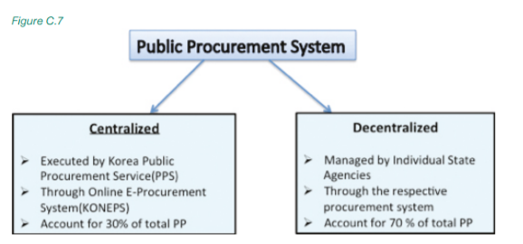
SPP in Republic of Korea
Public procurement in the Republic of Korea is undertaken via two different systems: a centralized and a decentralized system.
Notes:
Estimated total procurement expenditure (2014 – includes only goods not services or works):
Central government: USD 15 050 billion
State-owned companies: USD 41 844 billion
In total for the National Government: USD 56 894 million
Estimated % as part of the overall government’s expenditure:
Central government: 5 %
State-owned companies: 8 %
In total for the National Government: 7 %

Slide 31
SPP in Republic of Korea
SPP INDICATORS – Expenditure in green products
USD 56 894 million
7 % of the overall government’s expenditure

Slide 32
Implementation activities
SPP in Republic of Korea
online platform for e-procurement provided through centralised procurement agency, called Public Procurement Service;
nationwide training offered to over 6 000 public officials from November to December every year aiming at developing plans, compile data, and report results on SPP;
annual publication of SPP by the Ministry of Environment providing technical assistance to procurers on SPP implementation and reporting
public recognition of organization’s good practices in implementing and monitoring the SPP through awards and dissemination via the media
financial and reputational bonus
Notes:
SPP has been integrated into this system, so that procurers can purchase goods, services and works and easily monitor their SPP records
training sessions can be organised by request during the year, and be tailored to the specific needs of each public organisation.

Slide 33
SPP in Republic of Korea
Benefits associated to the green products purchased

Slide 34
SPP in Republic of Korea - Success factors
Establishment of Green Public Procurement criteria based on Korea Eco-label and Green Recycled Mark
Limitation of administrative costs
Establishment of clear legal basis that gives a mandate to purchase green products nationwide
Promotion of SPP at national level
Well-established e-procurement system (KONEPS) through the central procurement agency
Successful monitoring of SPP
better data concentration
Annual publication of GPP guidelines by the Ministry of Environment
Provision of technical assistance to procurers on SPP implementation and monitoring

Slide 35

SPP in Norway
Estimated total procurement expenditure for the central government (2013): USD 23 403 million =
24% of the overall government’s expenditure
Resources invested in SPP: at the public procurement agency of Norway a total of four full-time equivalent jobs (FTEs) are dedicated to working with sustainable public procurement. This includes both social and environmental considerations and workers’ rights. The annual budget at Difi (including salaries) is estimated to be around 350.000-470.000 USD.
35
Slide numbers to be added
as shown alongside
Notes:
Climate Cure 2020, Measures and Instruments for achieving Norwegian Climate goals by 2020 (summary in English) published by the Norwegian Environment Agency, 2010

Slide 36
SPP in Norway - Institutional framework
Implementation of SPP put in the hands of several ministries:
Ministry of Labour and Social Affairs, led the elaboration of the latest SPP policy approved by the Government for SPP related to labour conditions.
Ministry of Industry, as it has the general responsibility for the development of laws and regulations on public procurement.
Ministry of Climate and the Environment, for the environmental aspects of SPP.
Ministry of Foreign Affairs, for SPP related to international policy on human rights and corporate social responsibility.
Agency for Public Management and eGovernment (Difi) for the implementation of SPP policies.
36
Slide numbers to be added
as shown alongside
Notes:
Latest SPP policy: The Strategy for Combating Work-related Crime was approved by the Government.

Slide 37
SPP in Norway - Implementation activities
In January 2016, Norway established a new Government Procurement Centre in charge of public contracts.
The goal is to implement more professional, efficient and simple procurement processes in the public sector while also obtaining lower prices, reduced transaction costs, wider use of e-procurement and higher regulatory compliance.
The centre will take strategic considerations, including environmental issues, into account while planning and carrying out the purchases.
37
Slide numbers to be added
as shown alongside
Notes:
Latest SPP policy: The Strategy for Combating Work-related Crime was approved by the Government.

Slide 38
Conclusion

Slide 39
2017 Global Review of SPP: Conclusion
The 2017 Global Review of SPP highlights how SPP is becoming a widespread practice.
SPP activities are on the rise in all types of organizations, including local governments, non-profits and private sector companies, both large and small.
Successful SPP requires a solid policy foundation, top-level leadership support and excellence in implementation.
Still considerable work needs to be done before sustainability considerations become regular criteria within bid specifications and contracts.
SPP is a key driver for more innovation and change as organizations respond to pressing climate, resource and social challenges.
39
Notes:
Language on SPP is changing. “Sustainable procurement” is commonly understood to mean that social, environmental and economic issues are being considered as part of procurement.
All 41 participating national governments have SPP commitments and provisions in either a sustainable or ‘green’ procurement policy or in other organisational policies. Compared to the 2013 Review, the inclusion of SPP as a key organisational process has increased in all policy arenas
SPP policies vary widely across national governments depending on their sustainable production and consumption or sustainability objectives.
national governments do not have a single, comprehensive SPP policy that covers the complete range of sustainability issues, but rather have several distinct policies that cover specific environmental and socio-economic issues.
In the coming years, we may see a shift in this approach towards a focus on a general professionalization of the procurement function and its broad use as a tool for sustainability policy advancement.
In nearly all cases, the same ministries or agencies that lead the development of the sustainable public procurement policies are also leading SPP implementation

Slide 40
2017 Global Review of SPP: Conclusion
Some national governments are shifting their SPP policies towards strategic procurement policies - where sustainability is one of several "pillars" or goals.
SPP goes beyond "picking greener products" and encompasses activities at every step of the procurement cycle.
SDGs and target 12.7 provides an opportunity to formulate a more standard definition and articulation of SPP practices and measures that will help in measuring progress and encourage adoption.
Transforming sustainable production and consumption patterns will require collaboration among all stakeholders along the supply chain.
40
Notes:
To overcome such barriers, stakeholders are looking at various national and international initiatives (e.g. UN 10YFP SPP Programme, ICLEI’s Procura+ or the SPLC) to provide guidance and expertise based on successful lessons learned.
The 2017 Review shows that there is still considerable progress to be made to define a set of measures that are meaningful but also practical. Stakeholders are clearly seeking better methods to monitor and measure the sustainability outcomes of SP – and by so doing, demonstrate their progress in meeting policy goals, such as reducing their greenhouse gas emissions and creating economic opportunities.
Collaboration is clearly the key to taking SP to scale. Globally survey participants clearly signalled their desire to collaborate at both regional and international levels collaboration to share the very best information, tools and processes to make SP successful.

Slide 41
Future plans
In the next Global Review of SPP (2019) we expect to see:
More participants and more standardized approaches to implementing SPP as the sector becomes more mature and organizations improve their monitoring, measurement and reporting practices;
An increased emphasis on supplier engagement;
Higher engagement of the public and private sectors;
More cross-sector exchanges of ideas and approaches.
41
Notes:
The 2017 Global Review results shows that measuring the environmental and social outcomes of SPP remains difficult as they are rarely presented with supporting quantitative data.
we expect to see more participants and more standardised approaches to implementing SPP as the sector becomes more mature and organisations improve their monitoring, measurement and reporting practices.
We also expect to see an increased emphasis on supplier engagement, as well as more cross-sector exchanges of ideas and approaches.
The private sector is a critical element of the value chain and progress cannot be expected through the adoption of policies and procedures by governments alone.
Transforming sustainable production and consumption patterns will require collaboration among all stakeholders along the supply chain.

Slide 42
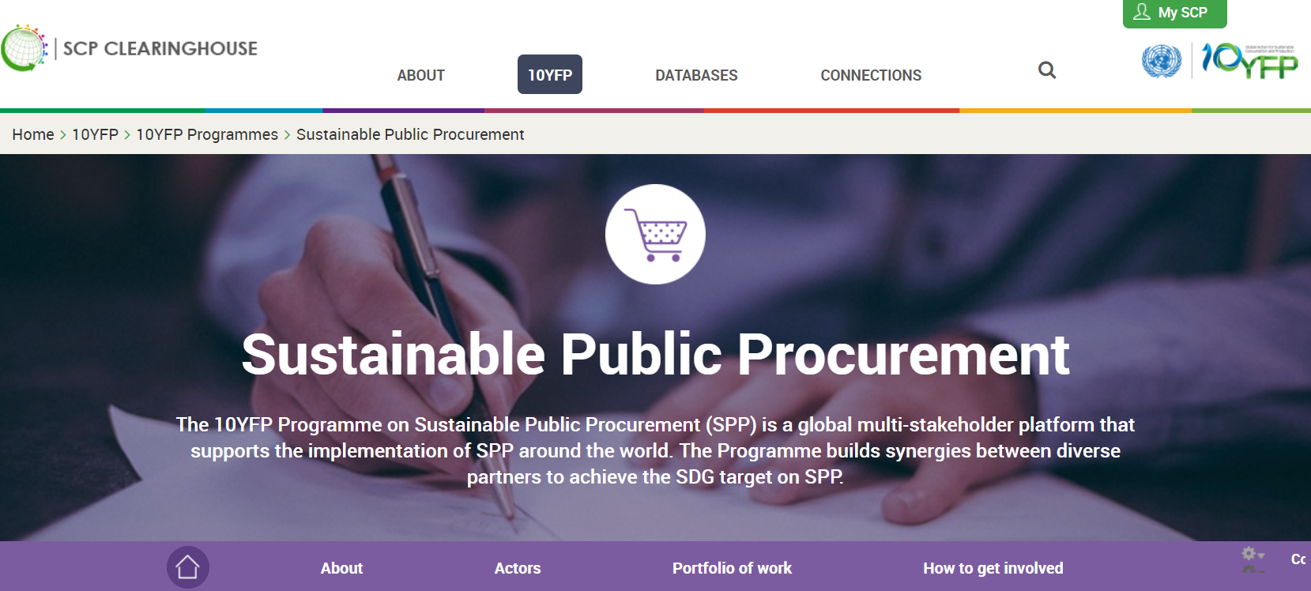
Learn more about the 10YFP SPP
discover our global partners
find all our publications
read our latest newsletter
On the global SCP Clearinghouse

Slide 43
Thank you - Дякую
Farid Yaker, Programme Officer /Economy Division
farid.yaker@unenvironment.org
www.unep.org

