Slide 1

Ecolabelling according to
ISO 14024
Role in the formation of green markets and in the field of public procurement.
Mr Björn-Erik LÖNN|Chairperson
Global Ecolabelling Network, GEN

Slide 2

Contents
ISO : Types of environmental statements (ecolabels)
Characteristics of Type 1-ecolabels
Market value
Product groups
About GEN
International cooperation - MRA
The Global Ecolabelling Network | www.globalecolabelling.net

Slide 3
Types of Ecolabelling
There are different types of Ecolabels:
ISO Type I (=ecolabels), Type II (=claims), Type III (=EPD, environmental product declaration).
Other programs and associated labels developed by governments, retailers, and manufacturers for consumers/purchasers. (i.e. energylabel in EU; based on Ecodesign-directive)
What are Type 1- ecolabels?
Ecolabels identify products and services that are more environmentally preferable than their traditional alternatives. Only for the best !
What makes an ecolabel credible?
Credible ecolabels address impacts across the entire life cycle (LC) of a product or service; are awarded by an impartial third-party certification; and are multi-attribute (i.e. address more than one area of potential impact in a LC-perspective).
The Global Ecolabelling Network | www.globalecolabelling.net

Slide 4
Definition of Type 1 ecolabel
ISO 14024 (2018) Clause 3.1:
Type I environmental labelling programme
Voluntary, multiple-criteria-based third party programme that awards a licence which authorizes the use of environmental labels on products indicating overall environmental preferability of a product within a particular product category based on life cycle considerations
The Global Ecolabelling Network | www.globalecolabelling.net

Slide 5
Type I Ecolabels in the market
Key Attributes:
Voluntary, market-based tools for both B2C & B2B.
Address multiple environmental criteria across the entire product life cycle.
Based on a transparent, collaborative standard development process involving external stakeholders (e.g. government, industry, academia, NGOs, consumer groups etc.).
Credible by independent verification of products and services.
Confidence & Clarity:
Clearly identify environmental leadership products.
Help consumers quickly navigate to select genuinely greener products.
Help procurer officers to consider most relevant environmental issues.
Ecolabelled products are already independently audited against a scientifically robust, public environmental leadership standard. = Good enough as proof in GPP.
Standardized definition of green that is scientifically robust.
The Global Ecolabelling Network | www.globalecolabelling.net

Slide 6
Ecolabelled products in the Nordic Swan Ecolabel
Large product categories: Furniture, Textiles, Building chemicals
Consumer interest: Handdishwashing liquids, Cosmetics, Tissue paper, Diapers
B2B (GPP included): Office machines, Laundry services, Printing houses, Conference hotels
Raw materials: Fuels, Building panels, Printing paper
The Global Ecolabelling Network | www.globalecolabelling.net

Slide 7
Ecolabelled products
Examples among other GEN members
One product category: Building materials (India), Office electronics (TCO Development), Dairy products (Sri Lanka)
B2B/GPP-focus: Korea, Chinese Taipei, UL Ecologo
Consumer perspective: HongKong, Russia (EcoLeaf), Good Environmental Choice (Sweden)
Broad spectre: Blue Angel (Germany), EU Ecolabel, Nordic Swan
The Global Ecolabelling Network | www.globalecolabelling.net

Slide 8
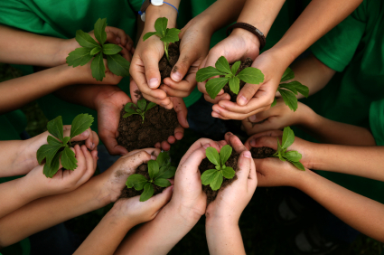
GEN: Who We Are & What We Do
Non-profit network of 35 Type I ecolabelling organizations around the world established in 1994.
Working to improve, promote, and develop the ecolabelling of products and services on a global scale.
Advocate on behalf of Type I ecolabels on international stage and articulate the distinctions between Type I ecolabels and other, less credible ‘green’ marks.
Help government officials, retailers, and consumers understand that not all environmental labels are created equal.
The Global Ecolabelling Network | www.globalecolabelling.net

Slide 9
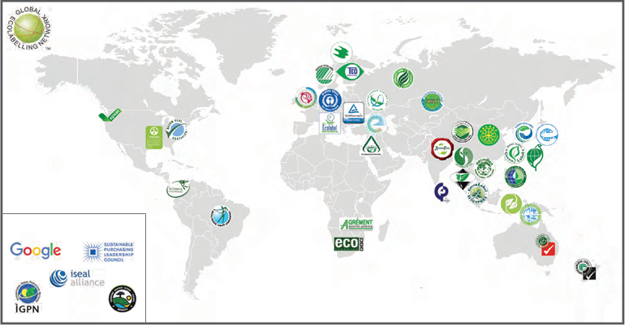
Who is the Global Ecolabelling Network?

Slide 10

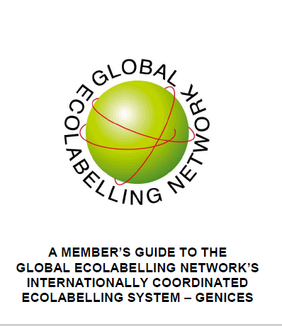
GENICES
GEN’S Internationally Coordinated Ecolabelling System
Multilateral approach toward mutual recognition (MR agreements).
Based on ISO 17065 and ISO 14024.
Involves application, preliminary docu-mentation review, peer review, and site visit.
Similar to accreditation, assures other members that member organization has good procedures and processes.
More than 90 % of all GEN members have undergone the GENICES process.
The Global Ecolabelling Network | www.globalecolabelling.net

Slide 11
Thank you !
For More Information | www.globalecolabelling.net
Contact Us | gensecretariat@gmail.com

