Slide 1
Fostering the demand for sustainable products
Key findings and recommendations
19 October 2021
Farid Yaker Programme Officer, Sustainable Public Procurement United Nations Environment Programme
.

Slide 2
Introduction: determinants of the demand for greener products
Rising demand
Price
Awareness raising
Policy and regulatory frameworks - GPP
International obligations
Sustainability standards - ecolabels

Slide 3
Facts and Figures
The global market for low carbon environmental goods and services is estimated at €4.2 trillion. EU companies' market share is 21% (UK Department for Business, Innovations and Skills, 2012)
There are currently more than 400 environmental labels worldwide (www.ecolabelindex.com).
26% of EU citizens often buy environmentally friendly products, 54% of them sometimes do (Eurobarometer 367, 2013)
39% of consumers say business claims about the environment are not accurate (GFK, 2011)
Environmental impacts are the third most important factor for EU consumers, after quality and price (Eurobarometers 2009, 2013)

Slide 4
Facts and Figures (2)
48% of consumers say current environmental labels are not clear (Eurobarometer 367, 2013)
Only 6% of EU citizens trust producers’ claims about their products’ environmental performance completely (Eurobarometer, 2009)
More than 1/3 of 250 business executives said that they could not keep up with consumer demand for sustainable products and services and 62% declared that sustainable investments were motivated by consumer expectations for green products (Accenture, 2012)

Slide 5
According to research conducted by NYU Stern’s Center for Sustainable Business from 2013 to 2018, the number of products marketed as sustainable grew 5.6 times faster than products that were not.
HP’s sustainability activities helped increase the company’s sales in 2019 by over $1.6 billion. And HP is not alone:

Slide 6
An increased interest/demand for sustainable products

Slide 7
https://files.worldwildlife.org/wwfcmsprod/files/Publication/file/93ts5bhvyq_An_EcoWakening_Measuring_awareness__engagement_and_action_for_nature_FINAL_MAY_2021.pdf?_ga=2.104714496.1018157384.1634635917-231319018.1630921833

Slide 8
According to the report, the popularity of internet searches for sustainable goods around the world has increased by 71% in just five years. Even in the midst of the ongoing COVID-19 pandemic, that number has continued to grow.
Rise isn’t limited to developed nations and advanced economies. The EIU report found a similar trend in many developing nations and emerging markets as well. Ecuador, for example, has seen a staggering 120% growth in consumer clicks for sustainable goods.

Slide 9
USA
The United States of America People all across the United States are becoming increasingly concerned about nature loss and are using Twitter to amplify that concern through social media campaigns, such as #NoDAPL, reaching a global audience.
Demand for sustainably produced goods is pushing Fortune 500 companies to implement ambitious sustainability measures, and politicians are following suit with some of the most ambitious policymaking in the country’s history.

Slide 10
GreenPrint Survey Finds Consumers Want to Buy Eco-Friendly Products, but Don’t Know How to Identify Them
Americans are seeking out and are willing to pay a premium for environmentally friendly products, according to a new study from GreenPrint, an environmental technology company.
The first-ever edition of the company’s Business of Sustainability Index found that nearly two-thirds (64%) of Americans are willing to pay more for sustainable products but most (74%) don’t know how to identify them.
According to the findings, 78% of people are more likely to purchase a product that is clearly labeled as environmentally friendly.

Slide 11
First Annual Business of Sustainability Index
https://www.businesswire.com/news/home/20210322005061/en/GreenPrint-Survey-Finds-Consumers-Want-to-Buy-Eco-Friendly-Products-but-Don%E2%80%99t-Know-How-to-Identify-Them

Slide 12
Situation in India
Consumer demand for sustainable products in India is relatively low compared with other countries.
The tide is starting to turn.
According to the Science Based Targets Initiative, India is the emerging economy with the largest number of companies committed to implementing Science Based Targets, which are designed to reduce the impact of business on the environment.
Twenty-five companies in India had signed up to the scheme in 2018, and that number rose to 38 the following year. Additionally, organic product sales have grown by 13% since 2018

Slide 13
Entire industries are changing as a direct result of increased consumer demand for more sustainable goods and services
The fashion and textile industry (which makes up between 1% and 1.5% of global GDP) is the second largest polluter in the world, ranking just behind the oil industry.
The industry has been pushed to change as a result of consumer demand. Over 50% of C-suite executives surveyed by EIU say that consumers are driving the focus on sustainability in the fashion and textile industry, followed by environmental activists (35%);
As a result of this pressure, 65% of the businesses surveyed have committed to sourcing sustainably produced raw materials, and 60% now collect data on supply chain sustainability.
Recognising that it takes 20,000 litres of water to produce just a single kilo of cotton, the use of water and other natural resources in production processes is being addressed.

Slide 14
Decisions made in Europe and North America are protecting nature and vulnerable workers many thousands of miles away
Government regulations and industry-wide sustainability commitments made in one part of the world can—and do—have a global impact on the protection of nature and biodiversity, even in parts of the world where domestic demand for sustainable products is still low

Slide 15
Cost implications
Consumer demand has pushed more and more industries to integrate sustainable practices into their goods and services.
However, the cost of re-orienting a business model towards sustainability is expensive.
According to an EIU survey, two-thirds of C-suite executives in the fashion and textile industry—a key driver of nature loss—believe that implementing sustainability measures results in higher operating costs.
For example, organic materials can be more expensive to grow, and implementing new production, distribution or monitoring technologies has significant upfront costs

Slide 16
Cost implications (2)
Some of these costs can be mitigated when sustainable solutions are implemented at scale, but the perception of cost still acts as a barrier. This perception matters, especially for small and medium-sized enterprises that may not have the money to make upfront sustainability investments in their supply chain.
Xerox reported savings of $400 million and Zara €500 million in 2009 by designing their products to minimise their life-cycle environmental impact.

Slide 17
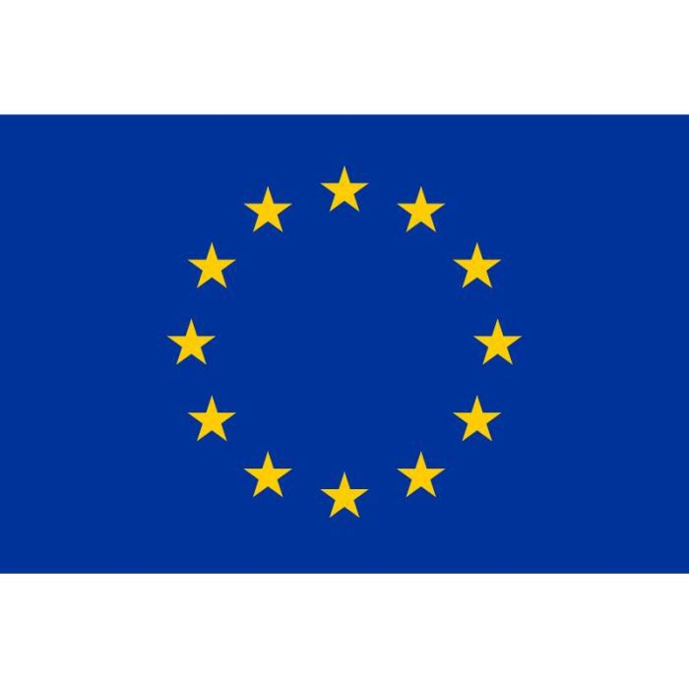
EU’s 2020 Sustainable Products Initiative
Part of the European Green Deal and will revise the Ecodesign Directive
Aims to make products placed on the EU market more sustainable.
New regulations will force companies that want to sell their products in Europe to meet tougher sustainability regulations.

Slide 18
Sustainable products initiative (2)
Consumers, the environment and the climate will benefit from products that are more durable, reusable, repairable, recyclable, and energy-efficient.
It will address the presence of harmful chemicals in products such as: electronics & ICT equipment, textiles, furniture, steel, cement & chemicals.

Slide 19
Expenditures in green products
▪ Korea’s GPP recorded around 3.88 billion USD in 2019 which has increased more than
4.2 times compared to the one of 2005.
4
3.5
3
2.5
2
1.5
1
0.5
0
3.88
25
3.43
3.31
2.84
20
2.41
2.04
2.2
15
1.58
1.63
1.64
1.65
1.73
1.34
10
10
10
10.8
10.4
10.6
0.79
0.86
7.9
6.9
7.5
5
5.3
5.4
5.3
5.3
6.1
4.5
4.9
0
2005 2006 2007 2008 2009 2010 2011 2012 2013 2014 2015 2016 2017 2018 2019
Total expenditure in green products(billion USD)
% of GPP over the total domestic purchase executed by PPS

Slide 20
Composition of GPP by product groups by year (unit: %)

Slide 21
Composition & Percentage of GPP by Product Groups in 2017 (%)
Percentage of GPP
Total Expenditure of GPP
100
Lighting, battery, electric materials 11.7%
Others 6.9%
90
84
80
70
60
57.7
Building and construction materials 47.9%
50
41
43.7
43.2
Office appliances,furnit ure, office supplies
16.0%
40
30
20
10
Electronic/electr ic/ITC equipment 17.5%
0
Building and Construction Materials Electronic/electric/ICT equipment
Office appliances, furnitures, office supplies Lighting, battery, electric materials
Others

Slide 22
KEITI conducted survey on the obstacles hampering GPP with around 5,000 procurers via Green Product Information System in 2018
the lack of diverse products
6%
6%
lack of awareness on GPP
8%
difficulties in meeting other
9%
competing procurement priorities
57%
Price
14%
Low Quality
Others

Slide 23
Growing market for eco-labeled products
20000
▪ GPP extend the eco-labeled products market
18,086
18000
16,647
16376
16000
14,647 14698
14000
13,352
12000
10,436
10000
9,140
8000
7,904
7,777
6000
4,639
4241
4000
3,643
3825
2,387
2,738
2,547
2000
1,63
6 1,636
1,841
2,025
₁₈₂326
941
0
37 82
1992
2001
2006
2010 2011 2012
Eco-Certified Companies
2013 2014 2015
Eco-Labled Products
2016
2017
2018
2019

Slide 24
Recommendations
Combine the regulatory framework with direct market instruments such as Green Procurement
Favor mandatory approaches
Ensure a high quality and credibility of sustainability standards and in particular type I ecolabels
Pursue awareness raising efforts and compliance with national and international obligations

Slide 25
Thank you! Дякую!
Farid Yaker/ Programme Officer / Sustainable Public Procurement
Farid.yaker@un.org
www.unenvironment.org

