Slide 1
The importance of credible sustainability information for sustainable consumption and production
Laetitia Montero
Associate Programme Officer, Consumer Information & Ecolabelling
Consumption and Production Unit
Economy Division - UN Environment Programme
laetitia.montero@un.org

Slide 2
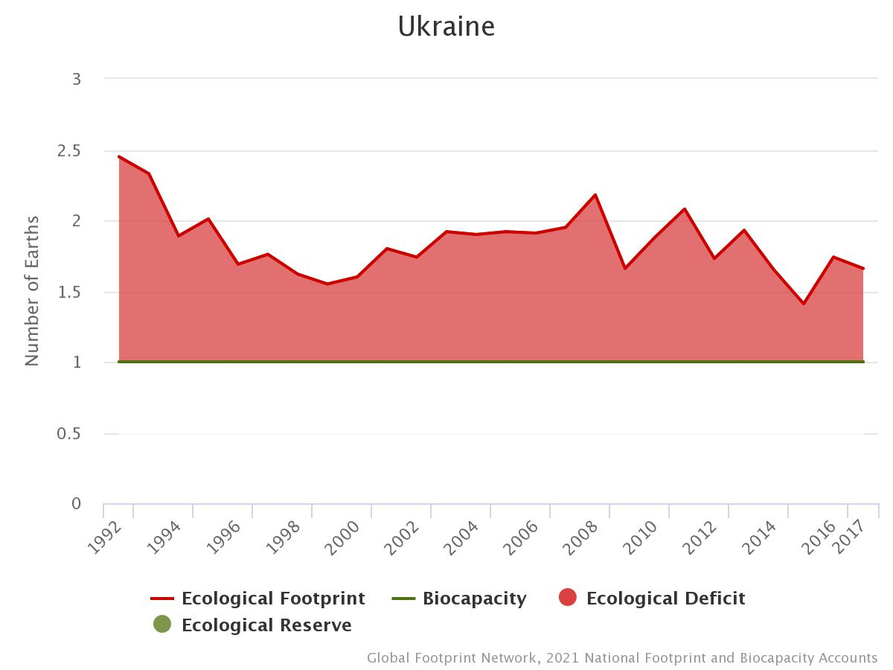
How sustainable is our way of life?
Source: Global Footprint Network
Notes:
MARINA: Paste global footprint network image on how many “earth” we need per year

Slide 3

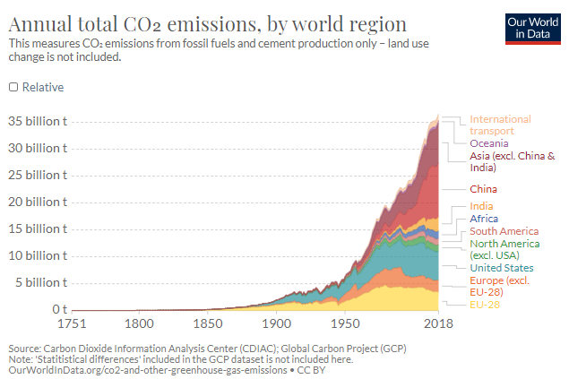
Climate
Notes:
Marina
Presentation notes
Meeting 2030 Paris agreement + icons will appear first
Meeting 2050 Paris agreement + flags will appear then
Conclusion line will appear last

Slide 4
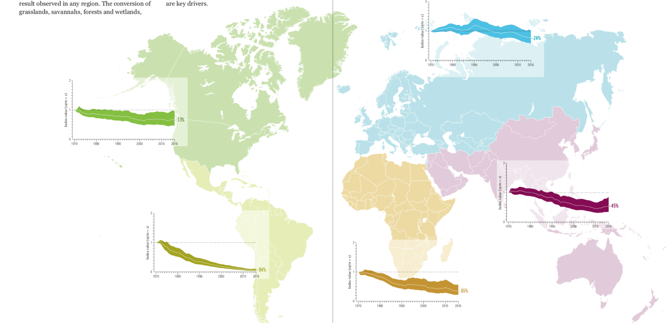
Nature Loss
Biodiversity is declining
Notes:
Marina

Slide 5
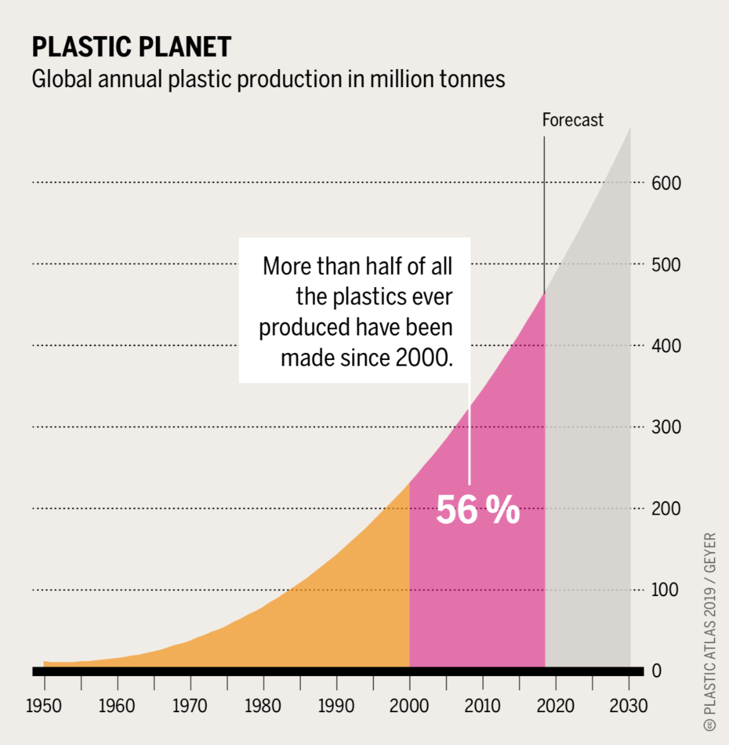
Pollution
Notes:
Marina

Slide 6

73% of consumers would change their consumption habits to reduce their impact on the environment
81% think business should be required to provide repair, maintenance and disposal support
83% think sustainability is important, but only 22% are ready to pay more for an eco-friendly product
Consumers want CHANGE
Notes:
MARINA
animation
How many people are affected by sustainability(Uniliver, 2017)
Why sustainability is important (GlobeScan 25-country & Akatu Brazil HSL 2019 Survey )
Even though consumer awareness and interest in sustainability issues is growing, behaviour is not following
WE need to transform our societies, identify a new paradigm and consumer information is part of the answer

Slide 7
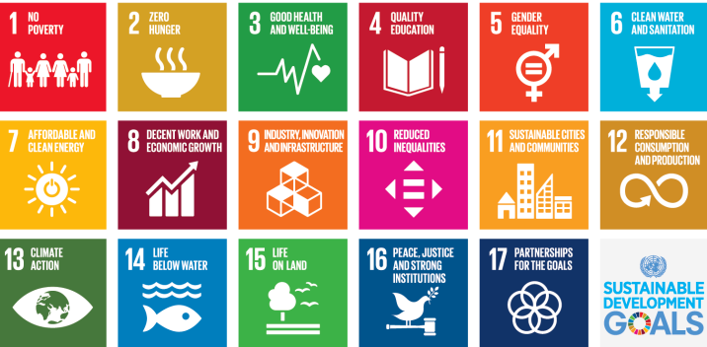
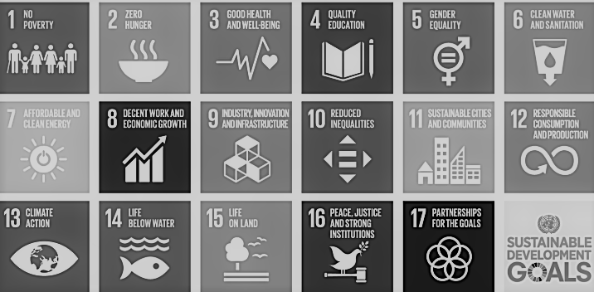

The 2030 agenda
SDG 12.8
Ensure that people everywhere have the relevant information and awareness for sustainable development and lifestyles in harmony with nature
Notes:
Marina: Insert the SDG

Slide 8





What is consumer information?
Information that consumers need to make an informed choice
To enable sustainable consumption choices, consumers need accurate and credible sustainability information
The assessment should be based on a holistic approach with a life-cycle perspective
To claim that a product is sustainable, one needs to assess its sustainability impacts. Consumer information tools are the means to communicate this assessment information.

Slide 9

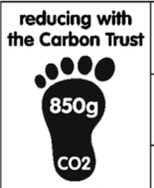

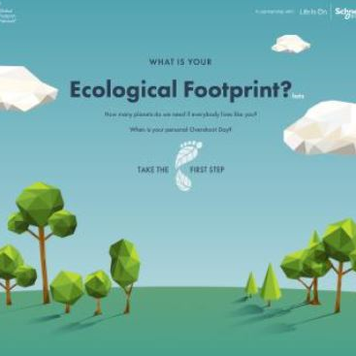

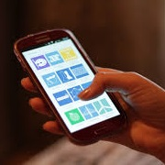
What are Consumer Information Tools?
All tools and systems that seek to guide consumers to make more sustainable choices on goods and services
Standards, certifications and ecolabels
Self-declared environmental claims
Ratings, rankings and benchmarks
Life-cycle and footprint assessments
Consumption and lifestyle calculators
Consumer information campaigns & Digital tools such as apps, games or web platforms
Notes:
MARINA: Link name with picture and add “animations”
Add global footprint network
FOCUS on self declared environmental claims & Ecolabel

Slide 10



What is their purpose?
Businesses
Governments
Consumers
A Marketing Tool
A Supply Chain and Risk Management Tool
Consumer Protection
A market-based approach to sustainable consumption
Demand can be driven through public procurement
Guidance for sustainable consumption choices
Awareness raising
Notes:
Marina
Please add animations :
1- businesses
2- Governments
3- Consumers
Governments – We support governments in developing enabling frameworks to strengthen the implementation of consumer information tools, and to align their procurement decisions on the basis of sustainability requirements. This enables governments create the demand which contributes to improving production processes and increasing the availability of sustainable products in the markets.
Private Sector – We provide tools and technical assistance to companies, especially small and medium-sized enterprises in developing countries, for them to strengthen their use of consumer information tools, to guide them in the improvement of their production practices and communicate this to consumers and stakeholders, enhancing their awareness of and influence over their value chain. We support producers to comply with relevant standards and certification schemes for improved market access both locally and through the creation of trade opportunities.
Standard-setting and Labeling Bodies – We work with standard-setting and labeling schemes to promote and improve existing consumer information tools. We also support alignment and harmonization of processes and criteria, while fostering mutual recognition of existing labels.
Consumers: A consumer can be an individual person, as well as a business or government purchasing, using and/or disposing of a product (good or service). By helping to improve consumer information we want to enable consumers to take better decisions. We also work with national and local governments and businesses as consumers, in order to improve their procurement and influence the overall sustainability of their value chain.
Research Institutions, Consumer Organizations and NGOs – Since they provide skills, knowledge and public awareness of challenges and solutions for consumer information, we engage research institutions, consumer organizations and NGOs as active partners. Research institutes and experts also contribute to strengthening the scientific foundation for consumer information.

Slide 11
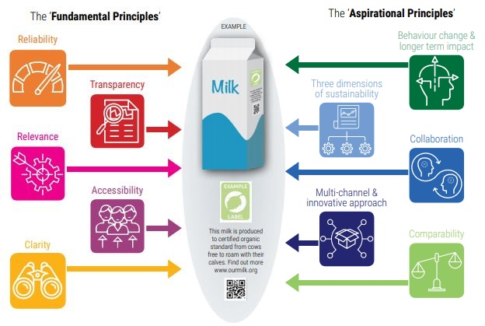
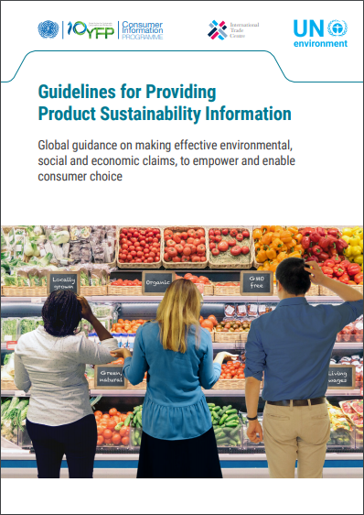
Self-declared environmental claims
Notes:
GVT: Rule to avoid green washing need to take that into account
Businesses: key for credible information
Ten principles to level the playing field and communicate in a reliable, fair and transparent way

Slide 12

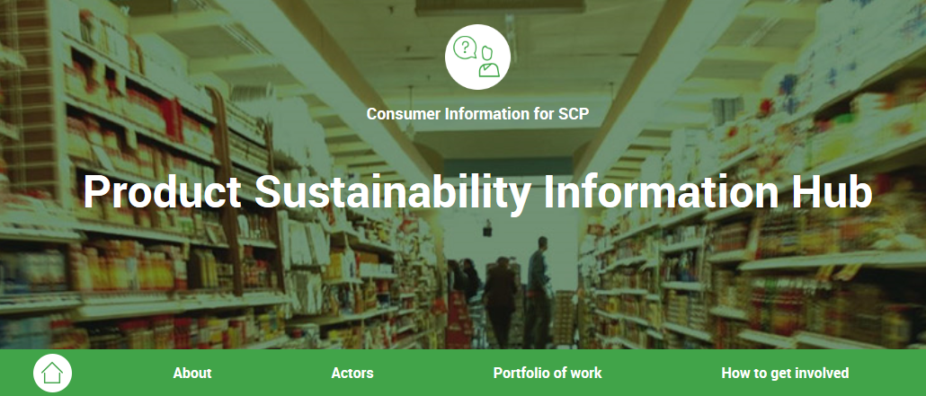
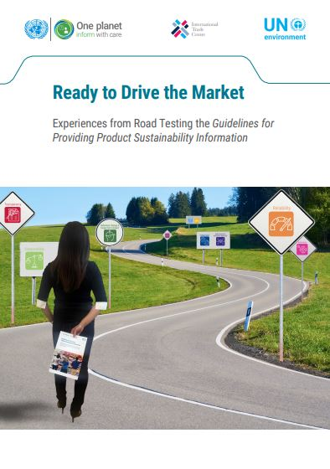
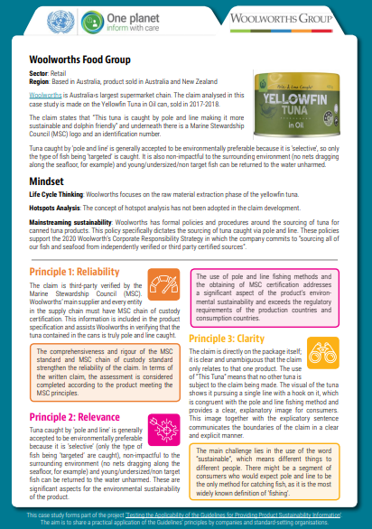
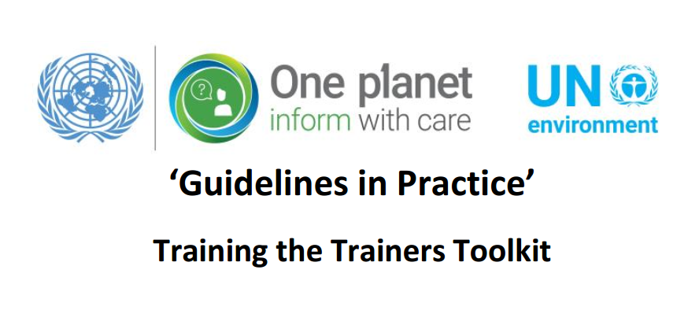
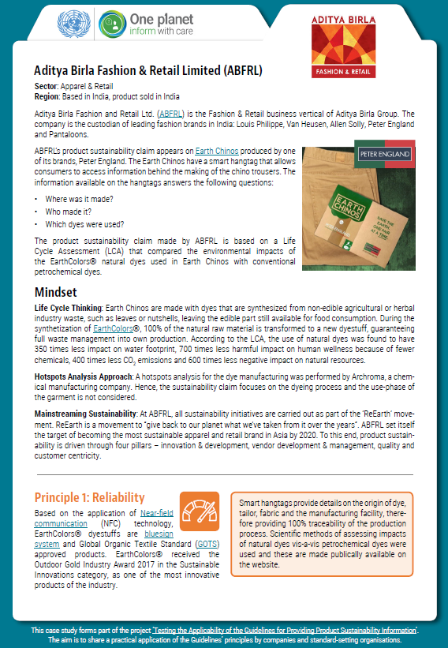


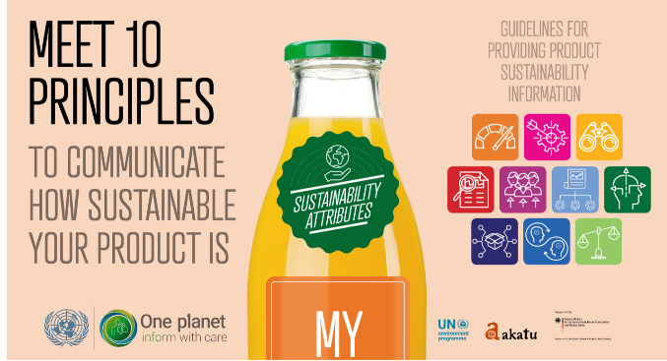
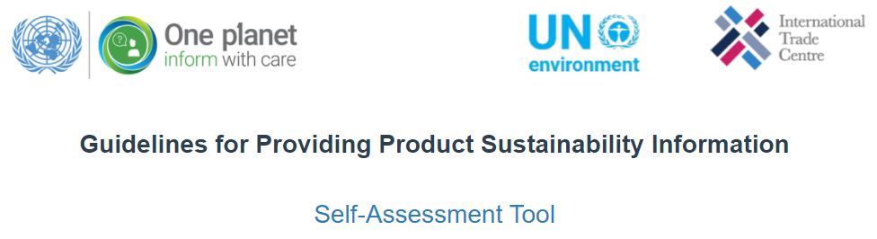
Tools at your disposal
Use these tools to promote the Guidelines and work with them!
https://www.oneplanetnetwork.org/consumer-information-scp/product-sustainability-information-hub

Slide 13

Eco-labels
A tool for:
Consumers
  Visual shopping guide ⇨ Easy to identify
  Third parties involved ⇨ Credible information
Governments
  provide market incentive to produce sustainable goods and services
  stimulate the demand for sustainable products through supportive measures such as public procurement ⇨ policy tool

Slide 14
SUSTAINABLE PUBLIC PROCUREMENT (SPP) AND ECO-LABELLING:
AN INTEGRATED APPROACH
SPP (Demand)
Through government purchasing power
Ecolabelling (Supply)
By identifying and verifying new
Ecolabels for more sustainable products
Combined approaches of voluntary labelling and SPP are important to:
→ Stimulate the demand and supply of better products

Slide 15
Inter-linkages
The exchange of competence and public investment (criteria development)
Networks and institutional procedures are already in place;
Promotion and marketing of the ecolabel raise awareness for SPP
The strategic development: products coverage aligned with PP
Notes:
The exchange of competence : capacity building on ecolabeling as a core element towards effective implementation of SPP; Stakeholders already in the work of the ecolabel scheme
The public investment which is spent for the creation of an ecolabelling scheme could be used also for the needed public investment for SPP (criteria development).
The presence of an ecolabel initiative lowers the hurdles to advance on SPP , because networks and institutional procedures are already in place;
The presence of an ecolabel scheme builds the foundation to raise the awareness and support of policy makers to invest in SPP implementation (ecolabel as model for governance). can be included in the process of SPP implementation;
Complementary, activities on the promotion and marketing of ecolabels (like information tools, campaigning) could be easily used in awareness raising activities within SPP.
The strategic development of the ecolabel's portfolio (products coverage) can be directly targeted to the application within procurement (like construction sector, public transportation).

Slide 16
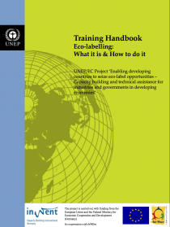


The One Planet Network (10YFP)
Free online training on ecolabelling over 3 days
To participate contact Laetitia Montero: laetitia.montero@un.org
http://www.oneplanetnetwork.org/initiative/working-group-2-type-i-ecolabels
Notes:
Marina

Slide 17
THANK YOU!
Laetitia Montero
Associate Programme Officer, Consumer Information & Ecolabelling
Consumption and Production Unit
Economy Division - UN Environment Programme
Laetitia.montero@un.org

