Slide 1


THE UNEP SPP APPROACH
The UNEP’s recommendations on definition and
application of SPP criteria
Farid Yaker
Programme Officer, Sustainable Public Procurement
United Nations Environment Programme
12 October 2021
.

Slide 2
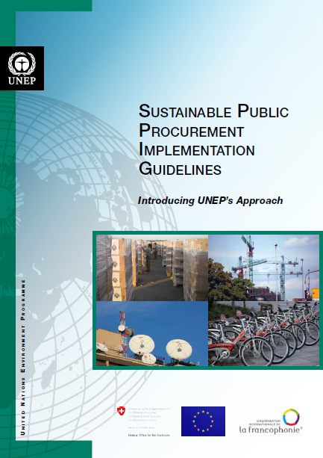
UN Environment SPP Guidelines
The Guidelines of UNEP’s SPP Approach incorporate the lessons drawn from the testing of the MTF Approach to SPP that UNEP rolled out in 7 pilot countries from 2009 to 2012.
Revised in 2017-2018 based on lessons learned from 2013 to 2019
To be published in November 2021
http://www.unep.fr/scp/procurement/docsres/ProjectInfo/UNEPImplementationGuidelines.pdf

Slide 3
UNEP SPP Approach
Status Assessment
Legal review
Prioritization
Market analysis
Selection of priority products
Procurement Guidelines
SPP Policy and Action Plan
Implementation
Notes:
Explain the relationship between the studies and the definition of the policy, underlining what each study contributes to the policy.

Slide 4
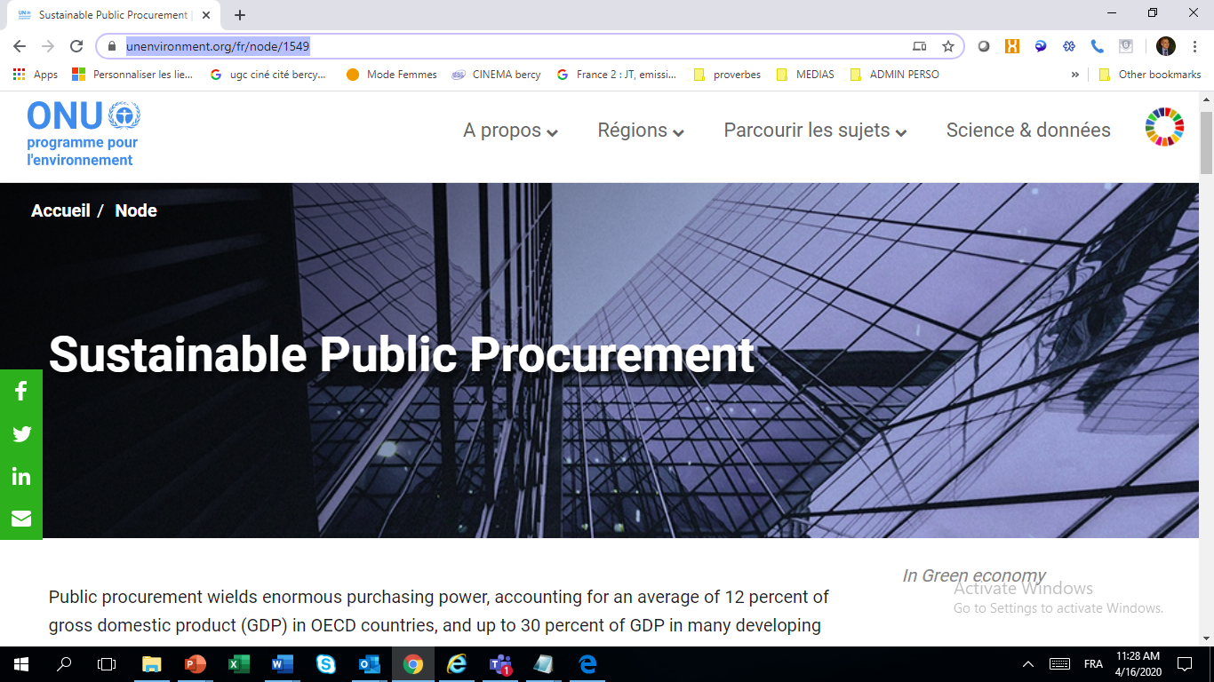
More information
UNEP SPP Portal
https://www.unenvironment.org/fr/node/1549
Projects’ Outputs
https://www.unenvironment.org/explore-topics/resource-efficiency/what-we-do/sustainable-public-procurement-and-ecolabelling
Notes:
Explain the relationship between the studies and the definition of the policy, underlining what each study contributes to the policy.

Slide 5
UNEP SPP Approach
Status Assessment
Legal review
Prioritization
Market analysis
Selection of priority products
Procurement Guidelines
SPP Policy and Action Plan
Implementation
Notes:
Explain the relationship between the studies and the definition of the policy, underlining what each study contributes to the policy.

Slide 6
2. Preliminary studies
Prioritization of products and services
Goals:
  To prioritize robustly and coherently according to:
    The risks of the different products and services
    The priorities of the administration
    The importance of the sector and the scope for action
    Market capacity

Slide 7
2. Preliminary studies
Overview of the Prioritization steps
A. Preliminary prioritisation of products
  STEP 1: Develop a preliminary list of product categories.
  STEP 2: List of most-purchased product categories
  STEP 3: Preliminary market study
B. Risks & benefits assessment
  STEP 4: Measure environmental impacts
  STEP 5: Measure socio-economic impacts
  STEP 6: Assess the existence of certification schemes
  STEP 7: Master table
C. Selection of final categories for SPP

Slide 8
II. Risks and benefit assessment
Master table
Objective: Summarize outcomes from previous tables to take all aspects into account for the final prioritization. Determine a weighing factor for each criteria (A, B, C, D, etc.) depending on the priorities of the procuring entities, by adjusting their maximum score
Types of products | Expenditures |  |  | (B) Average price premium of sustainable product (max score 8) | (C) Market availability of sustainable product (max score 10) | (D) Environmental impact max score 7) | (E) Socio-economic impact (max score 2) | (F) Eco-labels or certification systems in place (max score 5) | Total Score (A+B+C+D+E+F) | Final ranking
 | Total amount of contracts value (currency) | Share of the total amount (%) | (A) Score based on the total amounts (max score 10)
1. Sanitary cleaners | 3 258 913 880,72 | 45,90 | 10 | 5 | 8 | 7 | 2 | 0 | 32 | 1
2. Copying paper | 1 016 920 909,23 | 15,19 | 7 | 5.5 | 4 | 7 | 0 | 5 | 28.5 | 2
3. Drinks and beverages | 691 509 287,71 | 9,74 | 2 | 4 | 6 | 7 | 2 | 3 | 24 | 3
… etc.

Slide 9

III. Master table
Country example: Vietnam
Types of products | Eco-labels or certification systems in place (2) | Total amount of contracts value (3) | Market and price (4) | Environmental impact (5) | Socio-economic impact (6) | Total Score (2+3+4+5+6) | Final ranking
1. Printing paper | 10.0 | 6.7 | 7.5 | 7.9 | 6.7 | 38.8 | 1
2. Laptop | 10.0 | 5.0 | 6.3 | 6.3 | 2.5 | 30.0 | 2
3. Fluorescent lamp | 10.0 | 3.3 | 6.3 | 3.3 | 3.3 | 26.3 | 3
4. Wooden table | 5.0 | 3.3 | 6.3 | 5.8 | 5.0 | 25.4 | 4
5. Wooden chair | 5.0 | 3.3 | 6.3 | 5.8 | 5.0 | 25.4 | 4
6. Television | 5.0 | 5.0 | 6.3 | 5.4 | 2.5 | 24.2 | 6
7. Air-conditioner | 5.0 | 3.3 | 6.3 | 6.7 | 2.5 | 23.8 | 7
8. Monitor | 5.0 | 3.3 | 6.3 | 5.4 | 2.5 | 22.5 | 8
9. Printer | 5.0 | 3.3 | 6.3 | 4.6 | 2.5 | 21.7 | 9
10. Electric fan | 5.0 | 3.3 | 7.5 | 3.3 | 2.5 | 21.7 | 9
11. Public lighting system | 5.0 | 3.3 | 5.0 | 2.9 | 1.7 | 17.9 | 11

Slide 10
Market analysis
Goals:
  To assess the production capacity of sustainable goods and services in the country.
  To determine the market's capacity of response (imports/national production) for SPP (current and future requirements).
  To identify existing certification or verification tools, as well as gaps.
  To assist in the planning of activities for gradual implementation of SPP.

Slide 11
Market analysis expected outcomes
Identifying main sustainable product/service groups
Getting to know the production/import outlook
Identifying the role of Micro-SMEs in the production/import of the sustainable goods
Detecting measures for sustainable consumption and production policies and associated regulations.
Raising awareness among target sector companies.
Defining criteria for SPP.
Determining short, medium and long term actions.

Slide 12
Final outcome
A Market Readiness Analysis inclusive of a final list of prioritized products with proposed sustainability attributes, means of verification, and list of potential suppliers.

Slide 13
Country | Prioritised products
Ukraine | Detergents/cleaning products, paints and varnishes, insulation material
Moldova | Eco-efficient doors and windows, organic fruits and vegetables
Belarus | Paper, personal computers, boilers /boiler room, street lightning
Vietnam | Office copy paper, compact fluorescent lightbulbs (CFLs)
Mongolia | A4 Office copy paper, toner cartridges, lightweight concrete blocks
Mauritius | Recycled paper, ICT equipment, vehicles
Morocco | Paper, catering services, computers
Chile | Construction materials, dairy products, fruits and vegetables, fish, accomodation services (hotels) and catering services
Costa Rica | * 15 technical product sheets with sustainability criteria and any public authority can utilize these sheets that are published by the Ministry of Treasury, at any time.
Colombia | 43 technical product sheets with sustainability criteria and any public authority can utilize these sheets that are published by the Ministry of Environment, at any time.
Brazil | Wooden furniture, Printing paper, cleaning and hygiene products
Peru | Cleaning services (with some cleaning products), security/surveillance services, printing paper, wood furniture
Ecuador | Cleaning services (with some cleaning products), catering services, textiles, wood furniture
Argentina | Cleaning services (with some cleaning products), dairy products, textiles, wood furniture

Slide 14
Non-price Criteria for Public Procurement
Prioritized products in Ukraine
7) Paints
8) Cable products
9) Office paper and paper products
10) Wood
11) Detergents and cleaning products
12) Cleaning services
1) Road repair
2) Repair and construction work
3) Computer and office equipment
4) Catering service
5) Furniture (school, office)
6) Linen (bedding, lingerie)

Slide 15
Recommendations
Definition of criteria: in collaboration with the suppliers or manufacturers
Communicated to the market
Allow sufficient supply, local production, good scope for action, reasonable premium TCO,
Should be integrated in product specific Guidelines
The Sustainable Procurement Guidelines should address the whole procurement cycle with suggestions for selection criteria, technical specifications, award criteria and contract performance clauses.
The EU model uses the following structure: key sustainability impacts, followed by technical specifications and related means of verification, followed by selection criteria, award criteria and contract performance clauses.

Slide 16
Responsibilities and resources for the development of the Sustainable Procurement Guidelines, must be clearly assigned and the formation of committees with relevant stakeholders - users, technical experts, procurers and decision makers – to work on specific product groups is recommended.

Slide 17
Recommendations (2)
Sustainable Procurement Guidelines should – where possible - be developed by experts also involved in the preparation of eco-label criteria and the national standard setting organization
The development of Sustainable Procurement Guidelines is an iterative process during which ambitious criteria are tested on the market – and revised according to market readiness. Th
It is not about achieving the highest standard imaginable, but about doing better than the status quo. The new sustainable purchasing requirements included in the Sustainable Procurement Guidelines should be tested through pilot tendering.

Slide 18
Importance of stakeholder consultation in determining sustainable purchasing criteria – India
Room Air Conditioners were selected by the Task Force as one of the potential priority products for the following reasons:
1. room air conditioners have a high environmental impact across all its life stages. The room air-conditioning market has been growing fast in India, at an average rate of 18-20% over the last decade, reaching a market size of 7.6 million units;
2. room air-conditioners have high energy consumption costs which justifies the procurement of energy efficient models; and
3. integrated efforts of public entities such as the Bureau of Indian Standards (BIS) and the Bureau of Energy Efficiency (BEE), towards the procurement of efficient room air conditioners, provides for an enabling environment and ensures ease of implementing a Sustainable Public Procurement for this product.

Slide 19
India RACs consultation (2)
A collaborative expert consultation was set up to bridge the gap between the industry’s perspective on the recommendations and criteria outlined for Room Air-conditioners.
An air conditioning expert consultation was organized on January 7, 2021, with industry representatives and experts to seek feedback on the proposed criteria which included considerations such as safety and performance, energy consumption and building materials. Further feedback was gathered regarding the award of contract and contract clauses.

Slide 20
India RACs consultation (3)
The final output of the process led to a recommendation that authorities select variable-capacity room air conditioner, with minimum Indian Seasonal Energy Efficiency Ratio as per the 5-star level of Bureau of Energy Efficiency (BEE). Considering evaluation based on the Total Cost of Ownership (TCO) for products with higher efficiencies has also been recommended.
On 5 June 2021, on the occasion of the World Environment Day, the Government e-Marketplace (GeM) announced that it was including Green Air-conditioners onto its platform.
The process showed the importance of including various stakeholders early on in criteria development.

Slide 21
Green Public Procurement (GPP) criteria – European Union
The EU periodically issues new and updated GPP criteria to facilitate the inclusion of green requirements in public tender documents.
The EU GPP criteria page features links to 20 sustainable procurement criteria. The use of the criteria is voluntary. The criteria are formulated in such a way that they can be integrated into tender documents, if deemed appropriate by the individual authority.
While the EU GPP criteria aim to reach a good balance between environmental performance, cost considerations, market availability and ease of verification, procuring authorities may choose, according to their needs and ambition level, to include all or only certain requirements in their tender documents.

Slide 22
GPP Criteria – EU (2)
The EU GPP criteria can serve as a model on how to develop criteria. They are based on the most significant environmental impacts of the product, are based on life cycle data and are broken down into ‘core’ and ‘comprehensive’ criteria. They also clearly identify the verification method and involve stakeholders in the development.

Slide 23
GPP Criteria – EU (3)
First, a preliminary report and a technical report are developed. These are then open for consultation, by being posted on an accessible website and through in-person meetings open to all interested parties.
If the underlying criteria for an eco-label are developed or revised in tandem with the GPP criteria, the reports and consultation are used as a basis for both.
After a final report, the criteria are published on the dedicated EU GPP website
Available at: www.ec.europa.eu/environment/gpp/eu_gpp_criteria_en.htm

Slide 24

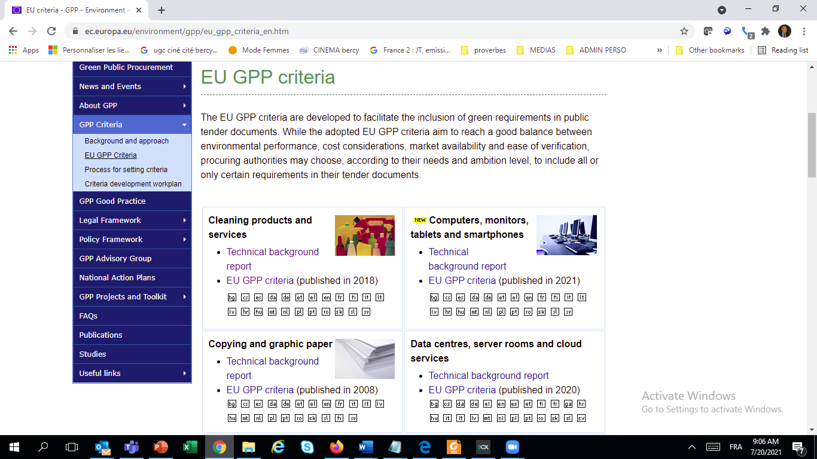
EU GPP Criteria for 20 categories

Slide 25


Farid Yaker
Farid.yaker@un.org
www.unenvironment.org

