Slide 1

Highlights of implementing Product Environmental Footprint (PEF) in businesses of Ukraine
BUILDING THE GROUND FOR A GREEN ECONOMY:
Lessons learned from cooperation
in the Eastern Partnership (EaP) framework
Brussels, 13-14 March 2024

Slide 2
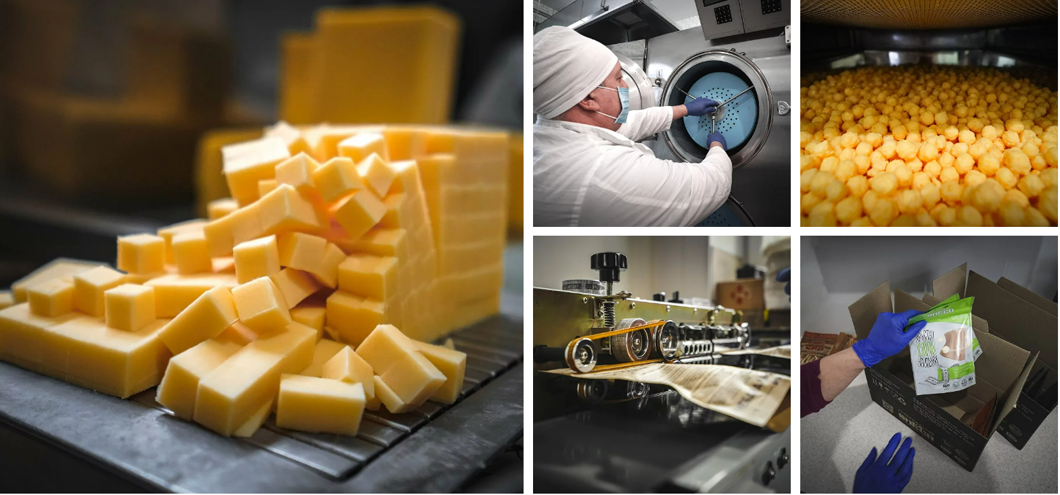
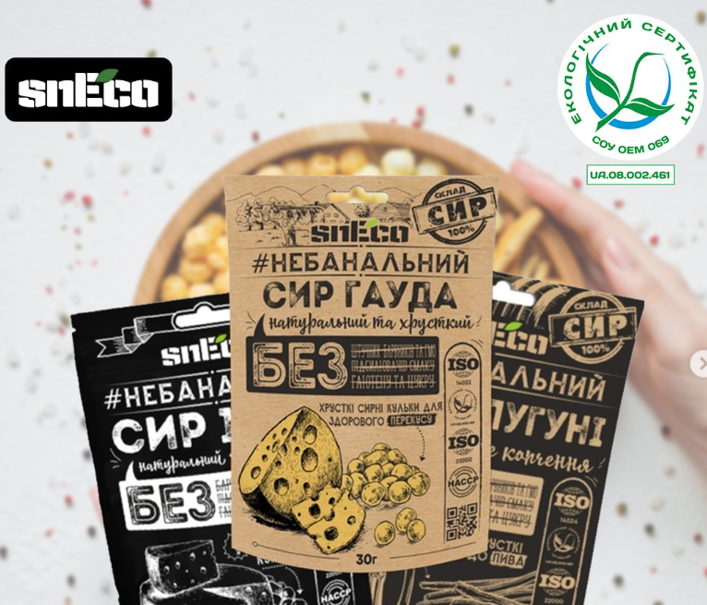
Pilot organization 1 - Prime Snack LLC, TM “SnECO”, Mukachevo city
Website: https://sneco.ua/
Product: vacuum dried cheese snacks
PEF expert: Svitlana Permynova
Notes:
My study was about a dairy product, a unique vacuum dried cheese.
I will not stop on technology, it will explained by the company.
Now you just need to now that it is a Dutch originated Gouda cheese, which is dried in Ukraine by the patented technology.

Slide 3
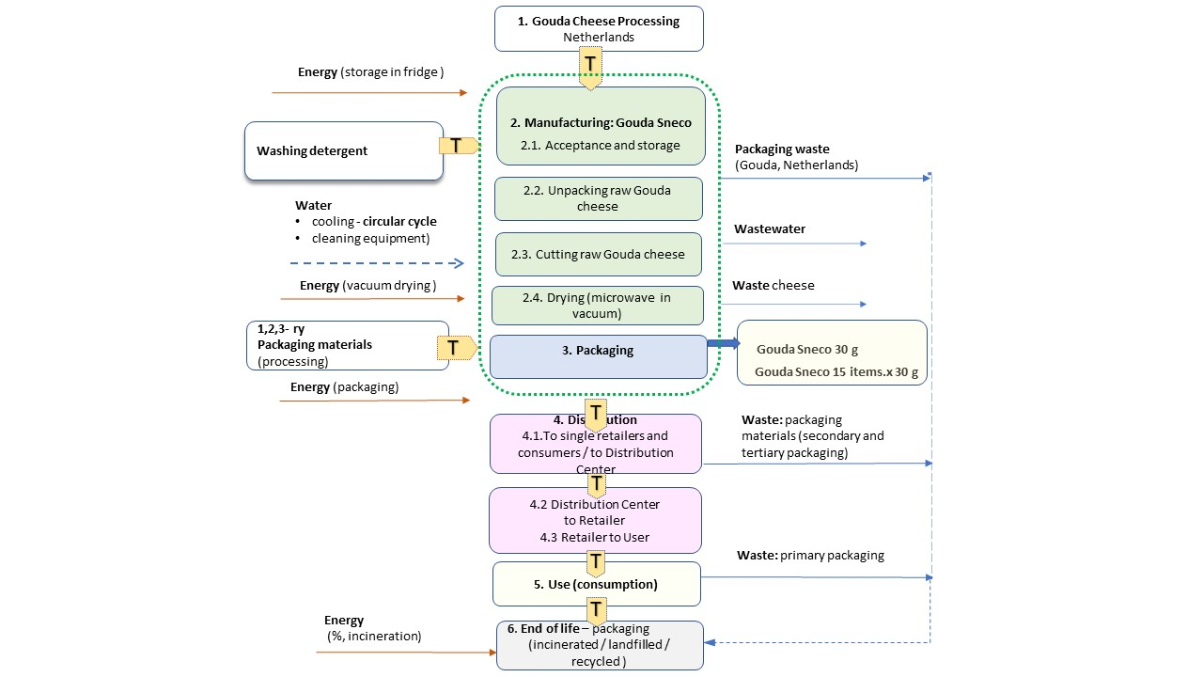
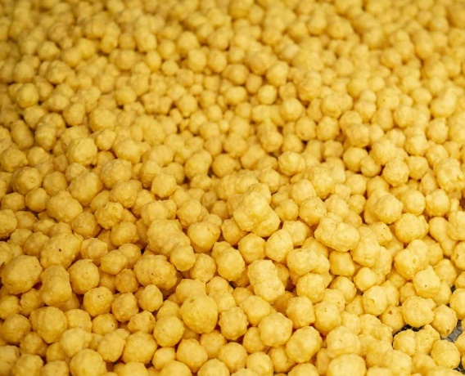
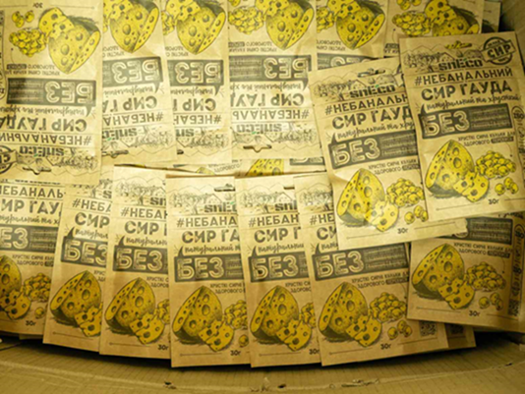
Dried foamed cheese lifecycle scheme and FU
Reference flow: Reference flow (RF) - 1 kg of dry foamed Gouda snEco cheese
The FU: cheese consumed at home as final product without cooking or further transformation – 30 g serving package
Notes:
Here you see some pictures of readymade product (packed and unpacked),
the LC scheme drawn by human at the right side (it is quite poor as you will see soon).
And a functional unit of the study. It is 30 grams of ready cheese made snacks.
So all the obtained resaults related with this amount.

Slide 4
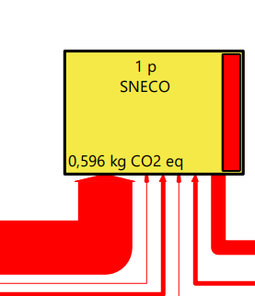
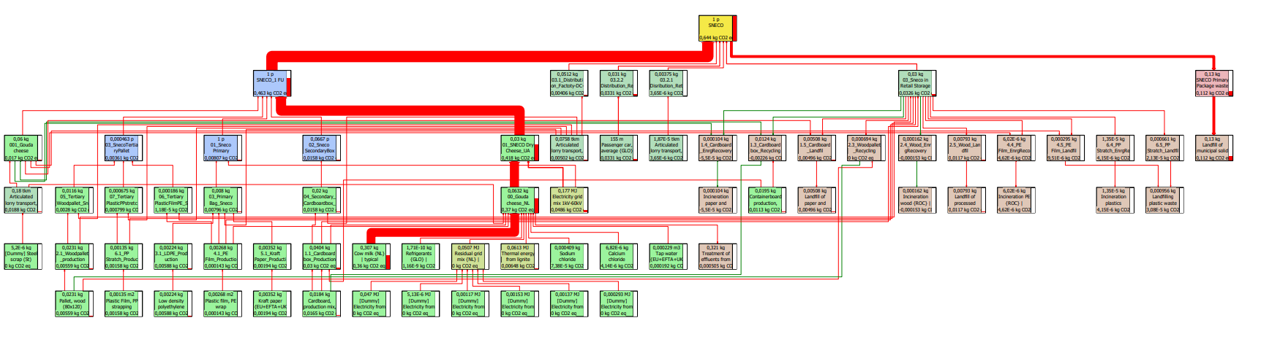

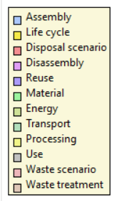
Product life cycle by SimaPro software
(CO2 emissions factor)
Notes:
"On this slide is a machine drawn LC.
We explore a SimaPro soft, developed by Pre-Sustainability company to build this.
And you see the difference with the human drawings.
The redlines are the mass and energy flows,
color of the boxes addressed to the different LC stages,
and a numbers / volumes inside shows us a level of product environmental impact in 1 one of 16 selected categories.
Here I selected CO2 emission, thus 30 g of Sneko cheese associated with 0,576 kg CO2 emissions during all LC, from cradle to grave.

Slide 5
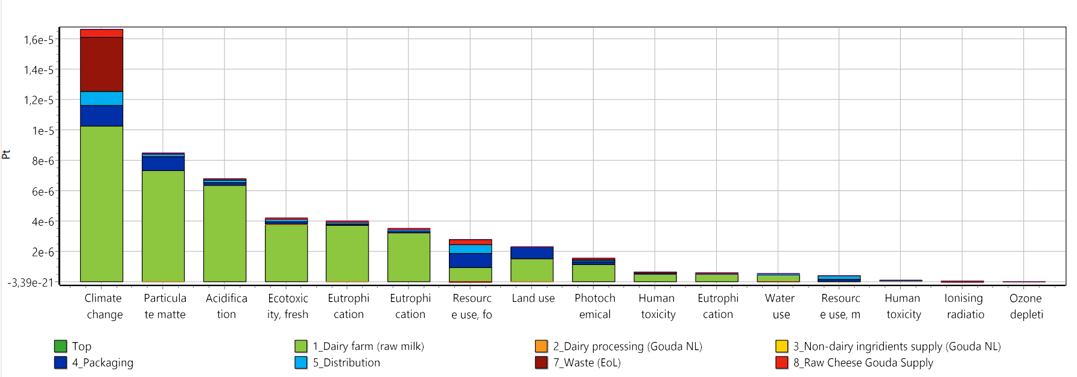
The most relevant impact categories
Climate change – 31,6 %, Particulate matter – 16,1 %, Acidification – 12,9%, Ecotoxicity, freshwater 8 %
31.6%
16.1%
12.9%
8.0%
Notes:
Within the framework of PEF study, we identify:
The most relevant impact categories (those of 16 , which create a 80% of total impact)
Most impactful LC stages
Most impactful processes.
1) The most relevant impact categories for the product are
Climate change – 31,6% - mostly associated with CO2 emissions
Particulate matter – 16,1% (microscopic solids or liquid peaces that are so small that they can be inhaled and cause serious health problems.
Acidification – 12,9% (reduction soil and water pH level, caused by so-called acid rains wich are the resault of diffrent emissions)
Ecotoxicity, freshwater 8%.

Slide 6
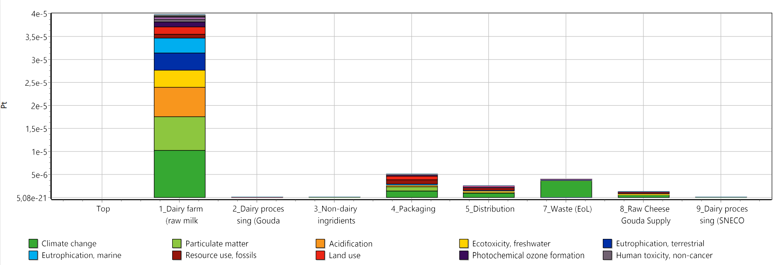
Most impactful LC stages
& Allocation of 16 environmental impact categories across snEco life cycle stages
Diary farm 75,5%, packaging 9,67%
75.5%
9.67%
7.57%
1.16%
4.66%
2.37%
0.0175%
Notes:
2) The most relevant life cycle stages for this product are
Raw materials production. In this case is milk production on a dairy farms in Netherlads- 75,5 % of total impact),
Packaging materials production– 9,67 %.
These packaging materials are not so much the primary packaging of Sneko cheese, but the secondary packaging - cardboard boxes and wooden papellets, as well as the packaging that remains after it was removed from the cheese from the Netherlands. The obvious negative effect of packaging is associated with the imperfection of the waste disposal system in Ukraine, where 98 is landfilled.
The most relevant processes for this product are
Cow milk production
Landfill of municipal solid waste

Slide 7
Case study- improvement opportunities
Sustainable raw material sourcing | Climate change (31,6 %) is identified as the most important impact category. Milk production is a significant contributor across a wide range of environmental impact categories, including particulate matter, acidification, and freshwater ecotoxicity. Therefore, it remains essential to prioritize milk suppliers that adhere to the best available sustainable practices when making procurement decisions.
Reducing packaging and shipping waste| 98% of transport package, raw materials and primary product package is landfilled in Ukraine contributing to climate change primarily through the release of methane and carbon dioxide, as well as through associated processes such as transportation emissions and land use changes. To mitigate these impacts, strategies aimed at minimizing the materials used, optimizing packaging design, improving shipping efficiency and partner with recycling facilities or third-party organizations to facilitate the recycling of packaging materials can be considered.
Environmentally-friendly shipping practices | To minimize the climate impact of raw material transportation, prioritize eco-friendly transport methods, optimize logistics networks by sourcing local suppliers, and implement bulk delivery strategies.
Notes:
As we see, the Prime Snack company cannot significantly impact on foreground processes such as milk production processes in the Netherlands or the waste disposal system. However, some recommendations can still be given.
it remains essential to choose milk suppliers that follows to the best available sustainable practices. Such as Friesland Campina - a leader in sustainable practices in milk production in the Netherlands. Moreover, this company supplied data to the European Commission when they developed the PEF methodology for Dairy products
98% of transport package, raw materials and primary product package is landfilled in Ukraine contributing to climate change primarily through the release of methane and carbon dioxide, as well as through associated processes such as transportation emissions and land use changes. To mitigate these impacts, strategies aimed at minimizing the materials used, optimizing packaging design, improving shipping efficiency and partner with recycling facilities or third-party organizations to facilitate the recycling of packaging materials can be considered.
minimize the climate impact of raw material transportation, prioritize eco-friendly transport methods, optimize logistics networks by sourcing local suppliers, and implement bulk delivery strategies.

Slide 8
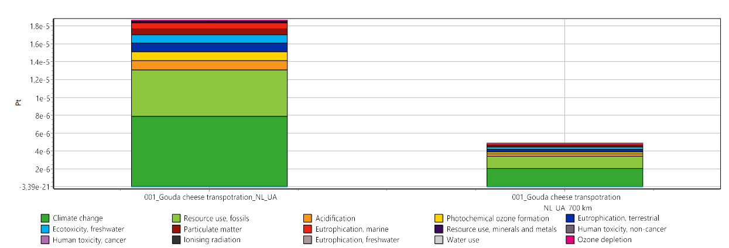
Assessing the environmental benefits of reducing the distance for sourcing raw Gouda cheese from 2700 km (the Netherlands) to 700 km
2700 km
700 km
Notes:
Now let's move on to the most interesting part.
Cheese is delivered from the Netherlands to Mukachevo, the delivery distance is 2700 km.
The most evident solution to reduce the environmental impact of a product is to use local cheeses. Such a solution can be made without complex modeling.
And on this slide we really see the benefit – the right figure are 3 times smaller (if we reduce the distance to 700 km). However, at a distance of 700 km it is not Holland if you are in Ukraine.

Slide 9
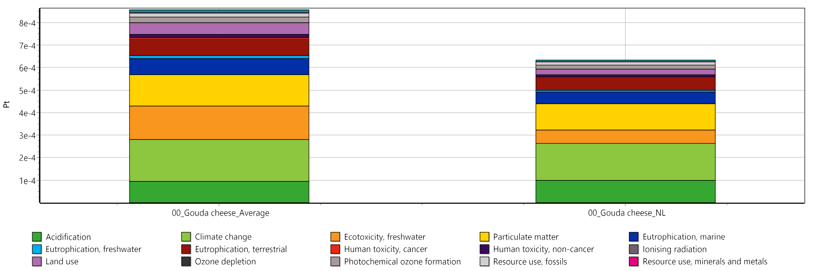
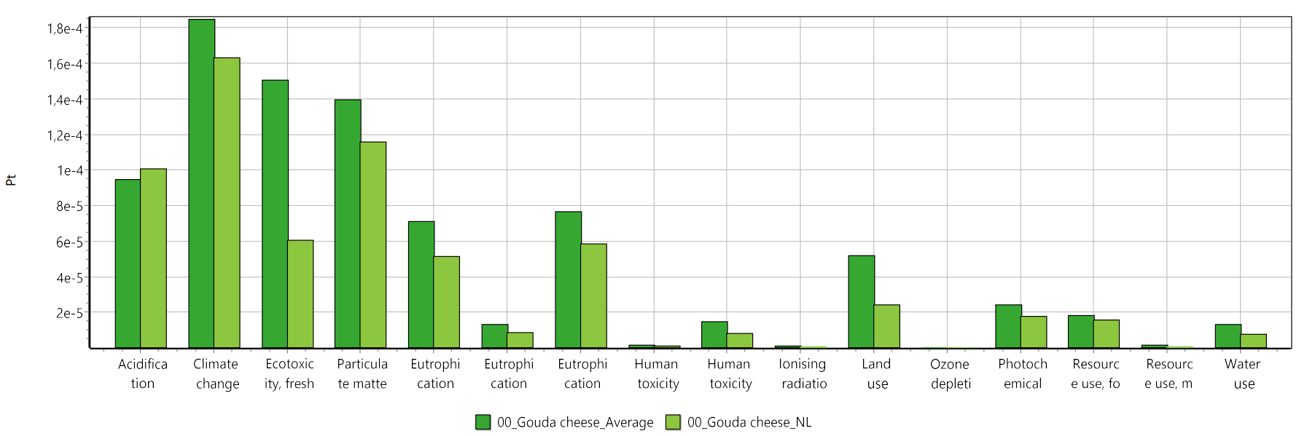
Cumulative environmental benefit
Gouda cheese average producer vs Gouda, Netherlands
Transportation distance 700 vs 2700 km (NL)
Gouda (average)*
Gouda from NL
Gouda (average)
Gouda from NL
Climat change
* Process: Cow milk {EU+EFTA+UK} | typical (average) production | production mix, at farm | FPCM (Fat Protein Corrected Milk) | LCI result
Сonclusion: no benefit.
Shortening the distance doesn't outweigh the benefits of choosing a Dutch cheese supplier.
To evaluate potential changes, a comprehensive approach is necessary – the PEF - study.
Notes:
This slide shows data on cheese produced in the Netherlands and cheese typical for an average European producer. There is no data for Ukraine , unfortunately (but worth to think about), so I took the prosess for random EU dairy farm.
I also carried out modeling for specific countries bordering Ukraine and I can say that the so-called Central European farm differs significantly from the models obtained for these countries. I am sure that in Ukraine milk production is still far from perfect. Thus, Sneko can be sure that such long-distance deliveries partly make sense if you choose the right suppliers
As it seen, Shortening the distance doesn't outweigh the benefits of choosing a Dutch cheese supplier.
This is a demonstration of importance of the complex LC- based approach which become reality with PEF – methodology and appropriate soft, as Sima Pro.
I would like to thank UNIDO for this opportunity to touch on the future of eco-labels,
the Center for Resource Efficiency and Cleaner Production,
as well as the Pre Sustainability team and especially
my consultants Rudri Mankad and Danai Mangana for their patience.
And our Ukr Enterprises whoch is in conditions of war not only produce somth, but also stay ambitious willing to improve their activity

Slide 10
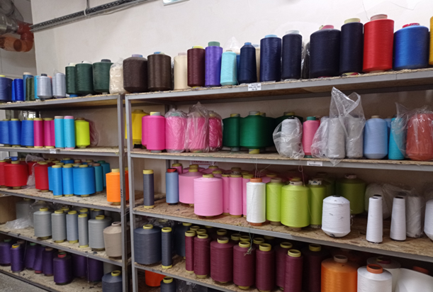
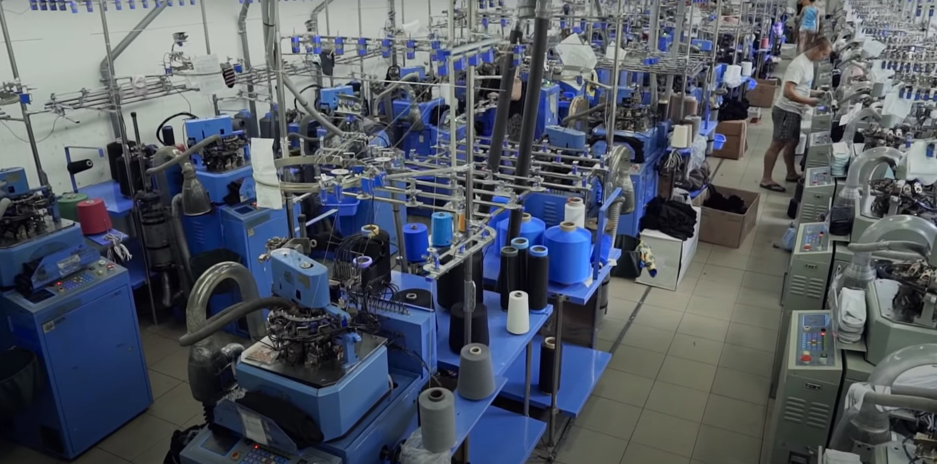
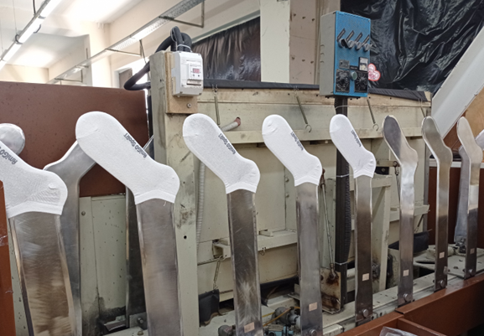
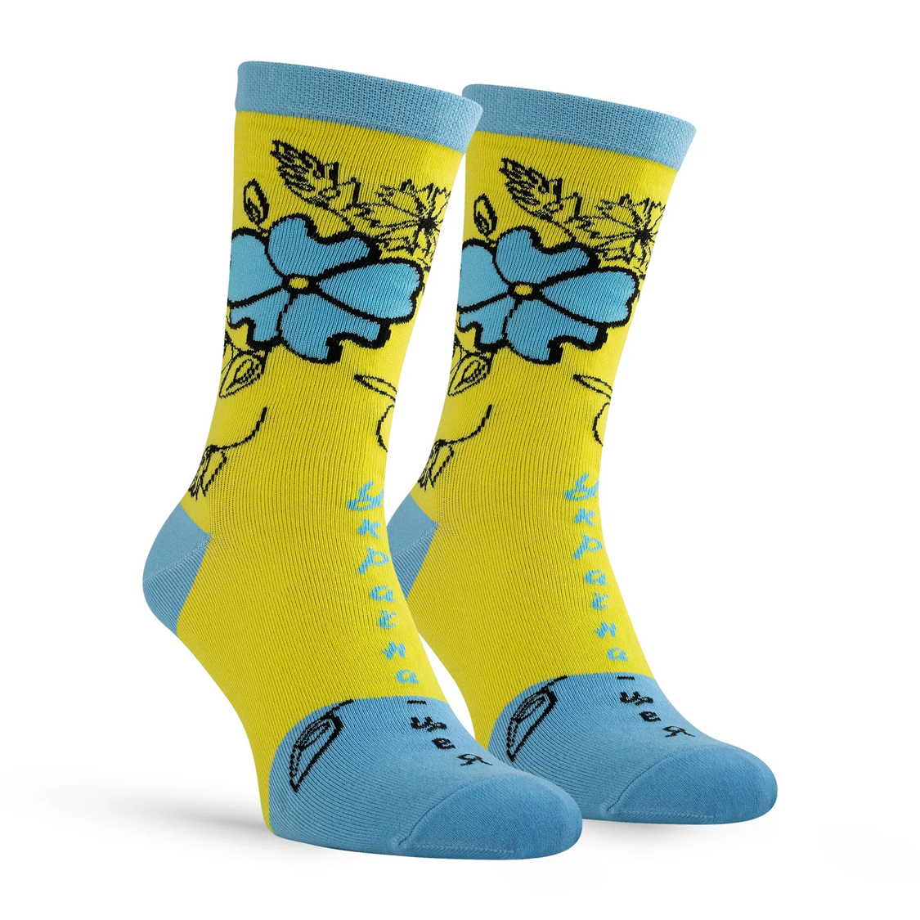
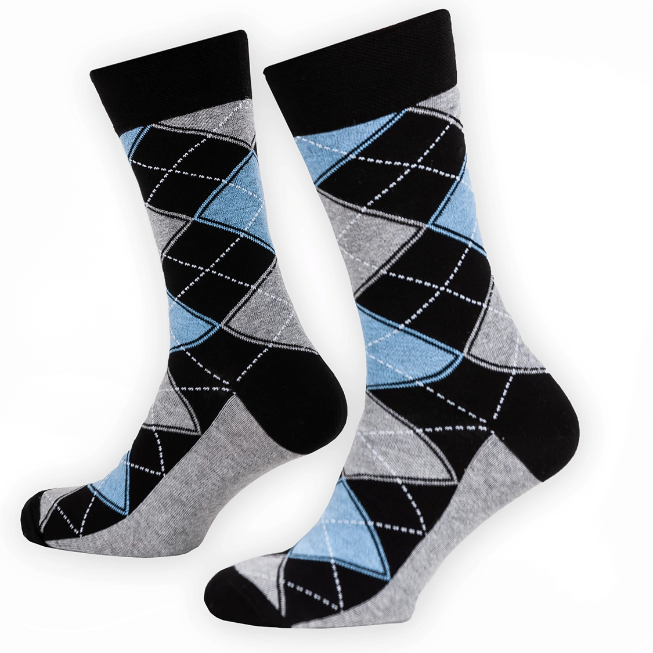
Pilot organization 3 - PE “ALFA HT”, Poltava region, Machuhi villag
Product: hosiery products (socks)
PEF expert: Tetiana Omelianenko
The company was established in 2014 Employees: 74
Main markets: Ukraine (with ambitious
to export to EU market)
Certifications/management systems: ISO 9001

Slide 11
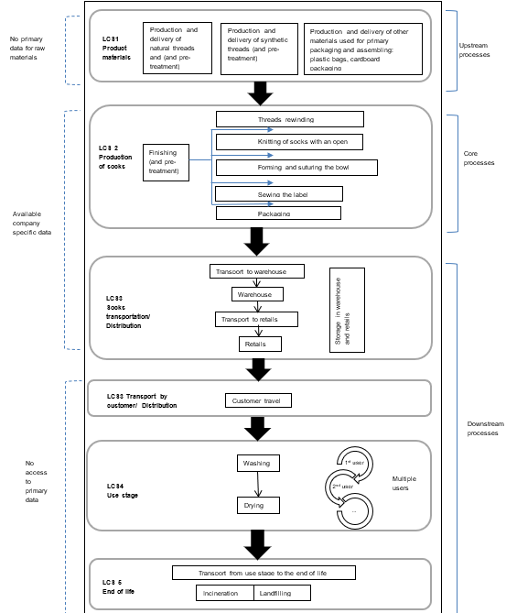
Socks lifecycle scheme and FU
Reference flow: 1 pair of sock/33.5 of the pair of socks
The FU: Provide comfortable wear for a person's (male) legs and feet for one day by wearing one pair of size 41-42 cotton socks in good condition (means 33.5 wears)”

Slide 12
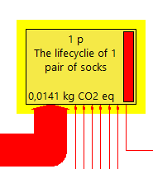
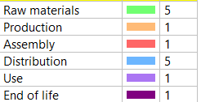
Product life cycle by SimaPro software
(CO2 emissions factor)
Notes:
"Product life cycle analysis conducted through Sim Pro software enhances the understanding of a product's journey from raw material extraction to disposal. Through this process, improvements in sustainability, efficiency, and environmental impact can be identified and implemented, ensuring a more sustainable and responsible approach to product development and management.«

Slide 13
The most relevant impact categories
Water use (48.4%), Climate change (16.7%), Particulate matter (8.87%), Resource use (8.24%)

Slide 14
Most impactful LC stages
& Allocation of 16 environmental impact categories across snEco life cycle stages
LCS1 Raw materials acquisition and pre-processing (79.6%) and LCS2 Production (18.5%)
The most relevant processes:
Electricity grid mix 1kV-60kV (36.7%),
Cotton fibre (35.8%),
Cargo plane (10.9%)
Notes:
"Product life cycle analysis conducted through Sim Pro software enhances the understanding of a product's journey from raw material extraction to disposal. Through this process, improvements in sustainability, efficiency, and environmental impact can be identified and implemented, ensuring a more sustainable and responsible approach to product development and management.«

Slide 15
Case study- improvement opportunities
Sustainable purchasing of raw materials: Water use (48.4%) is identified as the most important impact category. This related to the cotton harvesting and production technologies. Therefore, it is advisable to seek textile companies that use more eco-friendly and sustainable cotton harvesting practices.
Energy efficiency measures: The second impact process is an electricity grid mix during production stage. Impact reduction could be achieved through using alternative energy sources i.e. solar panels
Environmentally-friendly delivery of raw materials: The biggest impact related to the logistic of cotton. By exploring marked of other countries (where logistic will not require cargo plane transportation) will benefit to Co2 emissions reductions

Slide 16
Cumulative environmental benefit
Raw materials producers changes
Producers of the threads:
Sc_1: Country 1
Distance 3 380 km
Main transport: Cargo Plane
Sc_2 Country 2
Distance 670 km
Main Transport: Barge
Scenario 1 (base)
Climat change
Gouda from PL
Scenario 1 (changes)
Scenario 1 (base)
Scenario 2 (changes)

Slide 17
Conclusions
All mentioned above recommendations should be clarified with proper financial calculation how proposed for implementation measures can impact of general economic activity of the company. The rational solution to achieve economic & environmental balance should be developed.
Improvements related to the socks production require changes or related process of raw materials production which could be done within the separate PEF study for the main producers of cotton. Company has limited scope of intervention within some processes.
During the war some changes related to raw material supply could be limited.
The main recommendation to concentrate on what company can impact: energy efficiency, local logistic within distribution (choosing EUR 5 vehicles etc). This will have less within the general efficiency but could be more realistic for implementation.

Slide 18

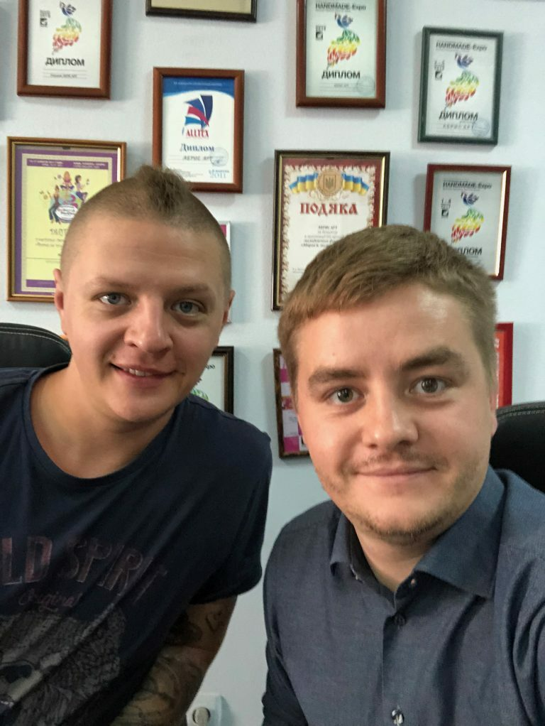
Expectations and anticipated benefits that drove PEF study
"Participation in project and PEF methodology application for our company allowed us:
to seek a deep understanding of the ecological footprint associated with our products, aling our business practices with global sustainability goals and demonstrate our dedication to minimizing our environmental impact.
to position our brand as a leader in sustainable business practices, fostering loyalty among environmentally conscious consumers, and differentiating our company on the market where sustainability is increasingly valued.
By sharing our experiences and findings, to play a role in raising awareness about the environmental impact of products and encouraging sustainable consumption practices among our consumers and business.
Adoption of an eco-friendly production strategies and sustainable practices is a crucial step towards conquering the EU market”
Phillip and Vadim Grishin,
Owners Prime Snack LLC

Slide 19
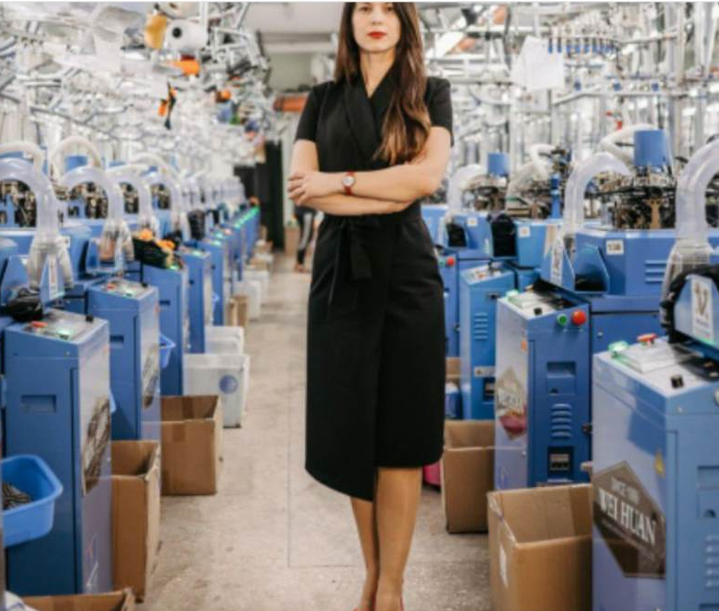
Expectations and anticipated benefits that drove PEF study
“Participation in project and PEF methodology application for our company allowed to see points for our intervention to run business in sustainable way with possible reduction of environment impact.
The company is committed to enhancing product sustainability to effectively enter the EU market and be competitive in EU market. PEF allows make a basis for this
By sharing our PEF study experience we have an intention to show importance of PEF methodology for other companies in Ukraine and necessity of database extension for PEF analysis by initial data from Ukraine.
Creation of PEF performance base for different companies will allow to simplify defining companies – providers of raw materials. This performance will be more detailed and comprehensive than each company-consumer of raw materials will try to investigate by themselves companies harvesting cotton in more environmentally friendly manner”
Tetiana Yahodiak,
Director LLC “ALFA HT”

