Slide 1
Made in Ukraine
CRUNCHY CHEESE BALLS

Slide 2
The company was established in 2016 as a hobby startup. At that time, we already had another successful business, but we had always been passionate about cheese. So, we began exploring ways to improve upon it. We asked ourselves, 'What can we do better? What is the cheese of the 21st century?' Through a gradual process, we discovered an innovative technology for dehydrating cheese, transforming it into a crunchy and even more flavorful form. Moreover, our cheese balls have a long shelf life, eliminating the need for refrigeration. They require no preservatives or flavor enhancers. Our product is the perfect healthy and natural snack for the modern era!

Slide 3
The biggest problem we tackled and solved after many experiments was how to make cheese last longer without needing a fridge. You see, cheese usually doesn't last very long and needs to be kept cold. For example, Mozzarella only stays good for a few weeks at temperatures between 3 to 9°C.
But with snEco's dried cheese products, we've extended the shelf life to up to 24 months, and you don't need any special storage or transport conditions. Our products have almost no water in them and can be kept at temperatures between 0 to 30°C.

Slide 4
main product advantages:
crunchy and tasty unique snack
100% natural cheese
only one ingredient - cheese
high in protein (up to 60%)
NO suragar, LOW carbs
100% gluten free
no additives, colorants etc.
long shelf life (up to 24 months)
no fridge needed (0 to 30°C)
great as a stand alone snack, as an ingridient of meal (soup, salad), or an addition to favorite drinks: coffee, wine, beer etc.

Slide 5
PATENT
№139035
HACCP
ISO 22000
ISO 14024
FSSC 22000
TCU 10.5-40271201-001:2016
СОУ ОЕМ 08.002.35.069:2012
SNECO PRODUCTS AND TECHNOLOGY ARE PATENTED AND HAS WORLD-CLASS CERTIFICATION

Slide 6
SNECO HAS A COMPACT AND SCALABLE PRODUCTION LINE

Slide 7
WE HAVE 13 DIFFERENT PRODUCTS IN OUR LINEUP

Slide 8
snEco
competitors
❌ typically mix other ingredients like corn or wheat with cheese, along with preservatives, flavour enhancers, and colorants
✅ 100% pure natural cheese, with only one ingredient, a healthy snack for the modern era
✅ dried using a unique modern technology at a low temperature (24-26°C) to preserve all the nutrients
❌ baked or fried products where the cheese is melted, leading to not healthy and the loss of nutritional value
✅ round shape, good finger food, no mess
❌ flat shape, dirty fingers from melted fat
✅ rich in protein (up to 60%), no sugar, no gluten
❌ low protein, with gluten and sugar
✅ KETO-friendly and environmentally friendly, as we use renewable solar power electricity
❌ obesity, cancer and other heals disease
friendly. not sustainable production.

Slide 9
Not only a product is unique: our packaging is remarkable
Multilayer packaging plays a vital role in ensuring the superior quality and freshness of snEco products. Thanks to its exceptional properties, it provides reliable protection and maintains the products' hygiene, thereby extending their shelf life for up to 12 months.
MULTI-LAYERED CRAFT PAPER + PE + BOPP + ALU PACKAGING

Slide 10
2022-2023: years of relocation
We were forced to move our facility, office, personnel to the safe, West part of Ukraine - Mukachevo city.
Despite of that fact, the war in Ukraine, great migration and dozens
of other problems, we continue to grow rapidly in Ukrainian market!
100000
75000
50000
25000
0
2023
2022
jan feb mar apr may Jun Jul aug sep oct nov dec
actual statistics of shipments, PCS per month

Slide 11
we are proud of cooperation with market leaders in Ukraine

Slide 12
snEco products have won numerous local and international awards across various categories.

Slide 13
2023-2024 EXHIBITIONS
WE ARE CURRENTLY PARTICIPATING OR HAVE FIRM PLANS TO EXHIBIT AT THE FOLLOWING EVENTS:
ANUGA, GERMANY
SANA, ITALY
SALON GOURMET, SPAIN
ISM, GERMANY
BEER AND FOOD, ITALY
FOODEX, JAPAN
GASTRO NORD, SWEEDEN
SIAL, FRANCE
We received strong feedback from buyers, distributors, and the HORECA sector, as well as from every individual who has tried snEco products. We have numerous cooperation contacts eagerly anticipating the opportunity to purchase snEco products in dozens of countries worldwide. This optimism fuels our belief in the future success of the product around the world!

Slide 14
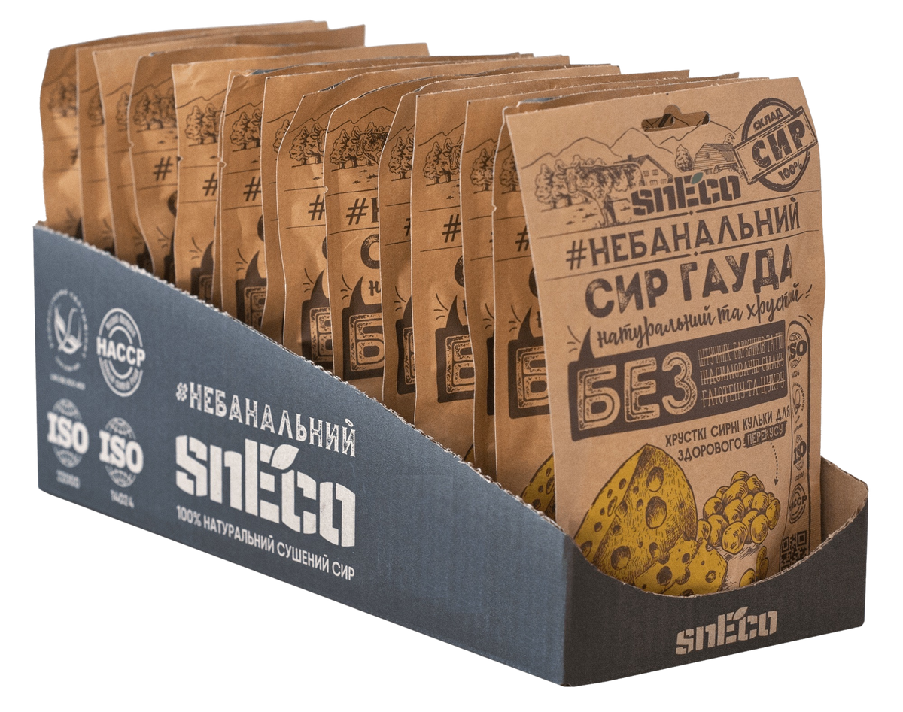
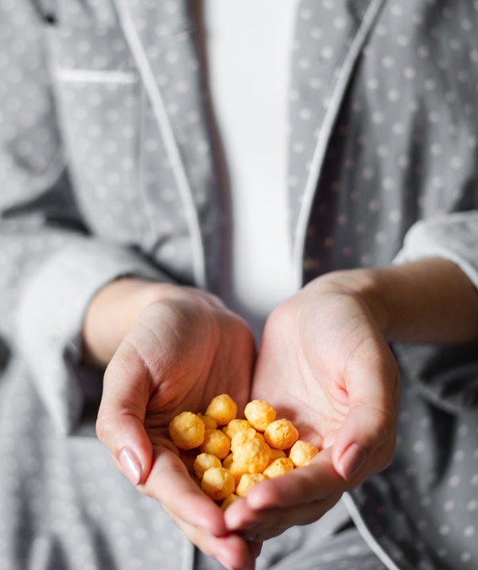
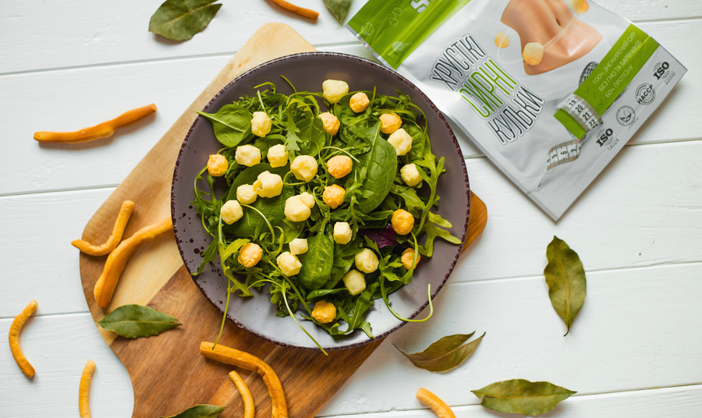
sneco.ua/en
vg@sneco.ua
We are open to exploring and engaging in various forms of cooperation
Scan it and get
in touch with our CEO

